Slide 1

How to Unleash the Power of Volunteers in Your Kitchen
Presenter: Kenneth Patterson
Kitchen Manager/Executive Chef, Wyoming Rescue Mission

Slide 2

How to Unleash the Power of Volunteers in Your Kitchen
TYPES OF VOLUNTEERS:
WHAT IT TAKES TO UNLEASH THEM:

Slide 3
1st we need to address a few issues every mission faces.
1st thing is TIME
It's going to take time.
Don’t be afraid to get personal with them
Be willing to let them know how valuable they are to getting your guests fed

Slide 4
1st, we need to address a few issues every mission faces.
2nd
The public perception of a mission is generally not good, so, take time to share with them what your mission does, and most importantly why.
Take time to answer their questions.
Point out guests that have graduated from your program and have in turn come to work for you because they want to give back.

Slide 5
Types of volunteers
Type 1
The volunteer that comes in minutes before the meal is served, serves and then leaves.

Slide 6
Types of volunteers
Type 2
The volunteer that comes in and wants to be behind the scenes.

Slide 7
Types of volunteers
Type 3
The volunteer that wants to BE!

Slide 8
Now that we know the 3 types, lets jump into each group and discuss how to unleash them.

Slide 9
Now let’s jump into each type and see how to unleash them.

Slide 10
Type 1 volunteers…
This group is the hardest to unleash. Your time with them is short and therefore needs a lot of focus.
1st , make sure you have almost no work left by time they get there.
2nd, utilize your time to get to know them.

Slide 11
Type 2 volunteers…
This group is your backbone in the kitchen. They are there to do whatever you need done. You usually have lots of time to visit with them.
1st , Be relatable and open.
2nd, Trust them and train them
3rd, Be willing to unleash them.

Slide 12
Type 3 volunteers…
This is where the fun can really become infectious...
1st , Don’t be afraid of letting go.
2nd, If your budget allows, get ingredients for dishes that they would like to cook
3rd, Be willing to pay for their ServSafe.

Slide 13
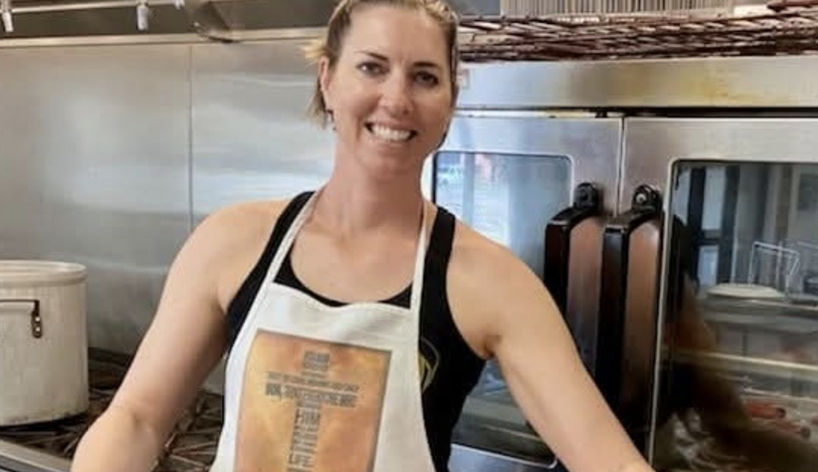

Slide 14
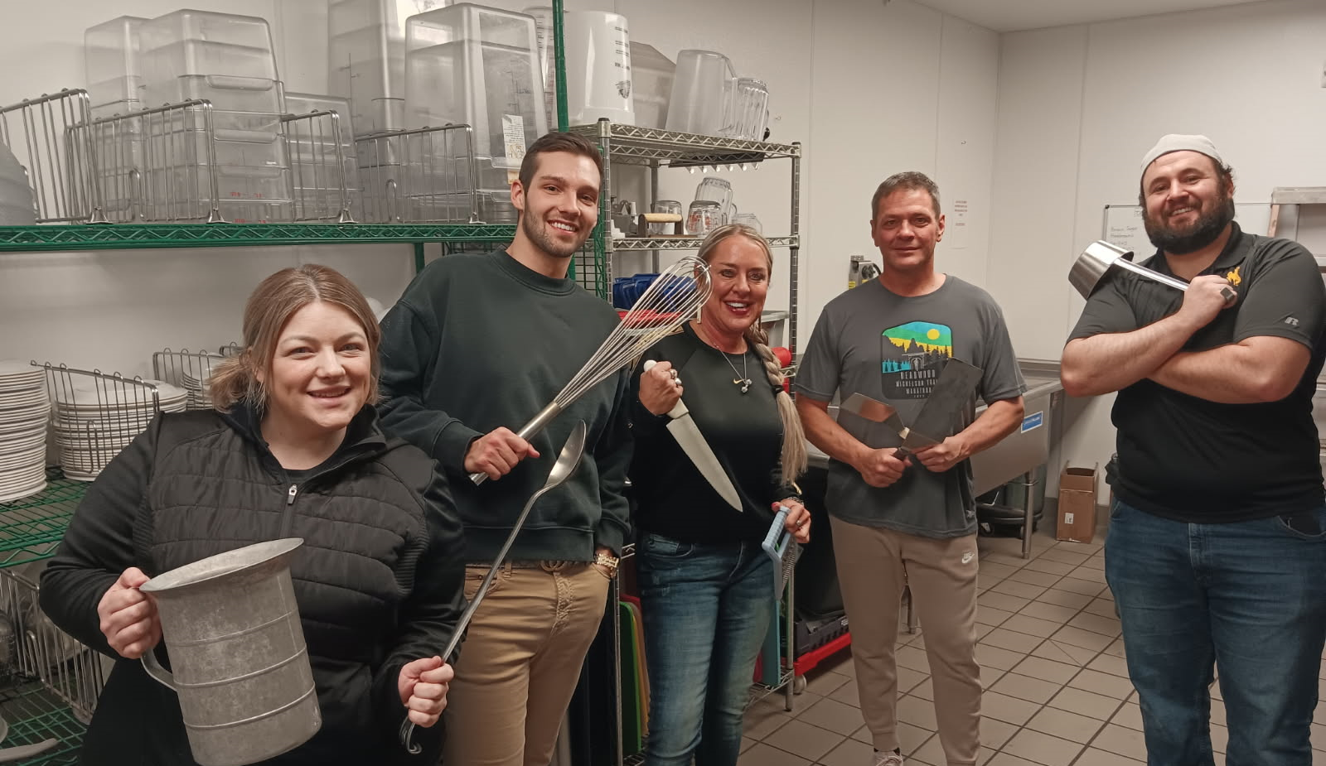

Slide 15
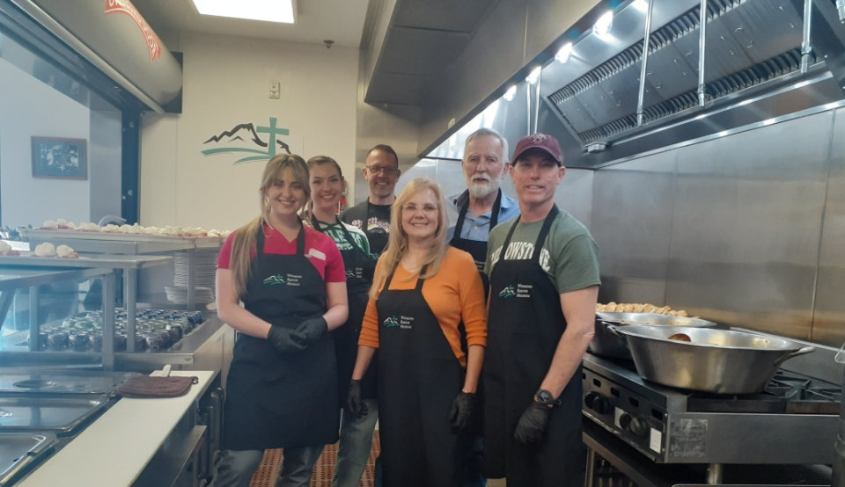

Slide 16
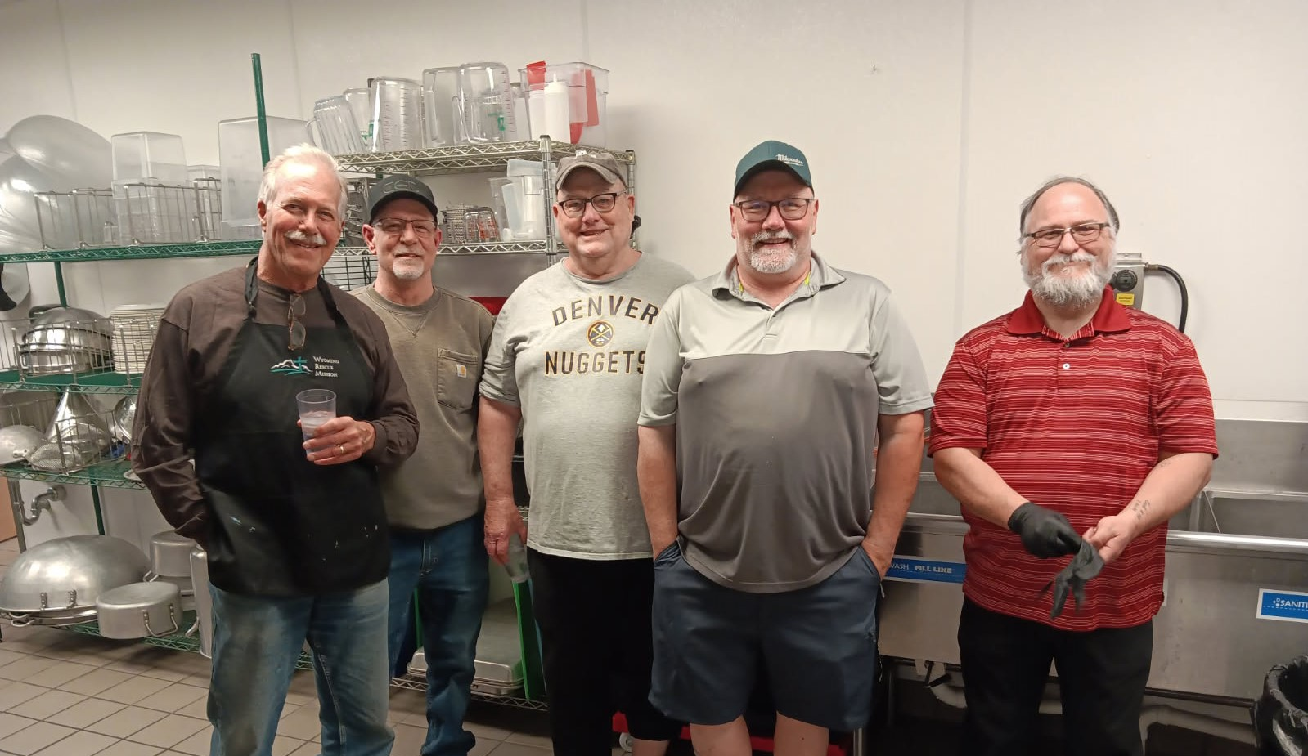

Slide 17
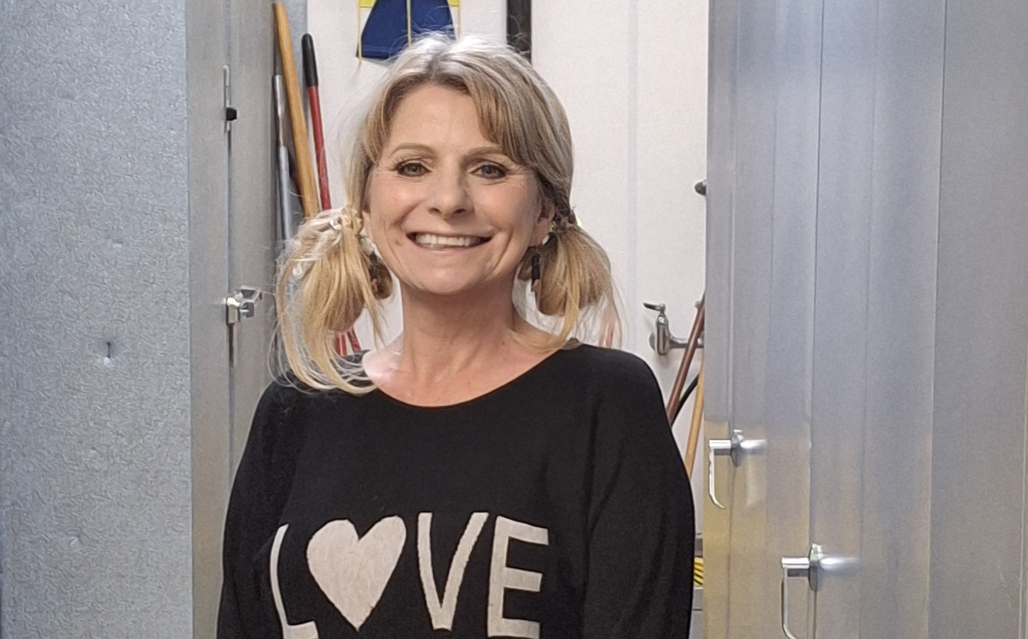

Slide 18
How to Unleash the Power of Volunteers in Your Kitchen
RECAP:
Time
Train
Be relatable
PRAY WITH/FOR THEM!!!
Step Back and unleash their power!!!

Slide 19
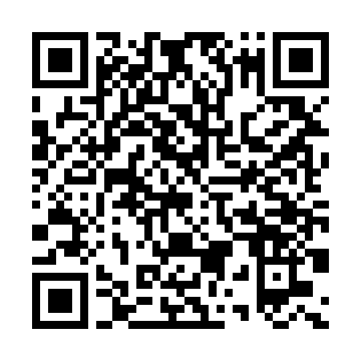
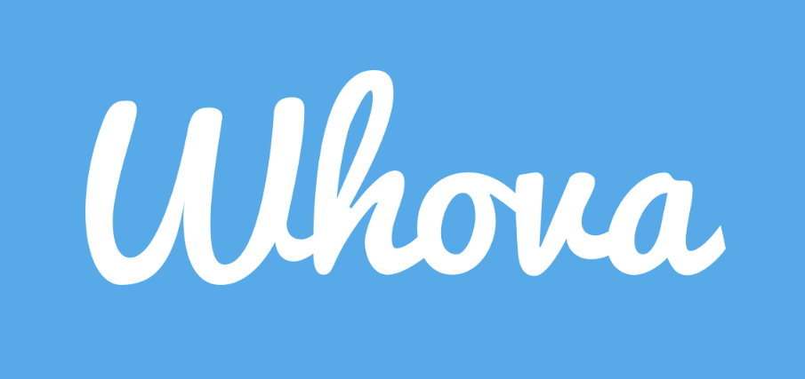
Don’t forget to download the app!

