Slide 1

Protecting Staff & Volunteers from the Dangers of Vicarious Trauma and Secondary Traumatic Stress
Presenter: Philip H Garvin LPCS
Clinical Director for City Union Mission, Kansas City, MO

Slide 2

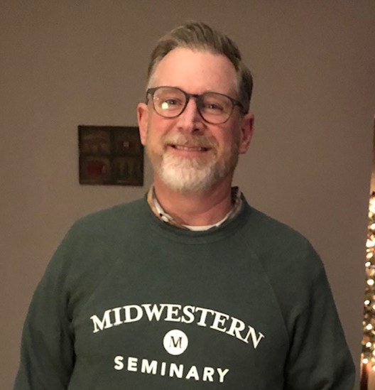
About Philip
Education
B.A. in Church Ministry, Nelson University, 1991
M.Ed. in Counseling, Dallas Baptist University, 1993
M.A. in Religious Education, SWBTS 1995
Ph.D. in Leadership, MBTS (hoping for graduation 5/2026)
  Dissertation: Overcoming Trauma-Induced Homeostatic Resistance in Faith Communities through a Trauma-Informed, Family Systems Approach to Leadership
Contact me: philip.garvin@cityunionmission.org

Slide 3
About Philip
Career Path
30 years Pastoral Ministry
24 years Counseling, Intervention, & Social Work
LPC in Texas and Missouri
3 years with City Union Mission as Clinical Director
Treatment/philosophical modality: “The Best B.E.T.”
A key strategic objective for my role to address: Secondary Traumatic Stress exposure for our agency
What I Do For Fun
Playing Guitar, Drums, Fly Fishing, Mountain Biking

Slide 4
Seminar Objectives
This presentation is designed for decision makers who have the responsibility of supervising “people-helpers,” and is designed to inspire participants:
Make informed decisions on how to best empower those “helpers” to protect themselves and their agencies from the damages of secondary traumatic stress that comes from serving others affected by trauma.
Learn and practice a few secondary traumatic stress reduction techniques that could prove helpful for “helpers” exposed to vicarious trauma/secondary traumatic stress.
Develop a comprehensive strategy to address secondary traumatic stress for their own agency.

Slide 5
Disclosures
The subject of trauma and examples of trauma material will be addressed in this seminar. At some point you may realize that you are experiencing an unexpected emergence of your own traumatic memories. It is entirely appropriate to take steps to attend to your own wellness.
No potential conflict of interests have been identified related to resources discussed in this seminar.
I adhere to an Integrationist approach to counseling, which means I able to honor the truth of Scripture and the aggregate body of behavior science data that is dependable and reliable for the task of understanding trauma and secondary traumatic stress.

Slide 6

Let’s Start with Calm:
Biblical Mindfulness

Slide 7
Biblical Mindfulness Practice
(Mind, body and Truth and cleanse of trauma)
I can do __
All things through __
Je sus Christ who
Strengthens me __
Philippians 4:13

Slide 8

Who is the room?

Slide 9
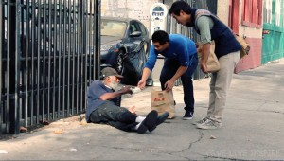

I. Key Terminology and Concepts

Slide 10
I. Key Terminology & Concepts
Trauma can be understood as any event that overwhelms our normal coping resources and harms our mind or body. (Gilbert-Elliot, 3)
Trauma causes the thought processes to become scattered and disorganized in such a way that they are no longer recognized as memories belonging to the original event. Fragments of memory are dispersed as images, body sensations, and words, stored in the unconscious, only to be activated later by anything remotely reminiscent of the original experience. (Wolynn, 15)

Slide 11
I. Key Terminology & Concepts
Traumatic experiences are often stored in “Non-Declarative” memory. An overwhelming event causes words to be lost so that the experience cannot be accurately recorded in language. Without words, we do not have access to our full memory so that fragments of the experience go unnamed, unresolved, and submerged out of sight. (Wolynn, 54)
Trauma: Emotions and physical sensations that are imprinted during trauma are experienced not as memories but as disruptive physical reactions in the present. (van der Kolk, 206)

Slide 12
I. Key Terminology & Concepts
Vicarious Trauma: is used to describe the traumatic exposure to the disturbing experiences of others
Vicarious Trauma describes the accrued effects of treating distressed clients, which will ultimately impact the helper’s feelings, intellectual schemas, self-efficacy, and sense of well-being so that it becomes an occupational health hazard (Sawicki, 26) (Dorociak et al. 2017)
Vicarious Trauma is a sign that the client’s history is having an extreme effect on the therapist. (Rothschild, 15)

Slide 13
“Vicarious traumatization is the transformation of the helper’s inner experience as a result of empathetic engagement with survivor clients and their trauma material. Simply put, when we open our hearts to hear someone’s story of devastation or betrayal, our cherished beliefs are challenged and we are changed. We view vicarious traumatization as an occupational hazard, an inescapable effect of trauma work. It is not something clients do to us, it is a human consequence of knowing, caring, and facing the reality of trauma.” (Saakvitne, 25)

Slide 14
I. Key Terminology & Concepts
Compassion Fatigue: a general term applied to anyone who suffers as a result of serving in a helping capacity (Rothschild, 14)
Burnout: reserved for extreme circumstances where a person’s health is suffering or life outlook has turned negative because of the impact or overload of their work (Rothschild, 14)
Secondary Traumatic Stress: the partaking of disturbing experiences, mainly in situations where the listener is extremely empathetic, and traumatic symptoms in the listener may be aroused that can be equivalent to those of the victim (Sawicki, 14) (Butler, Carello & Manguin, 2017)

Slide 15
I. Key Terminology & Concepts
Empathy: The action of understanding, being aware of, being sensitive to, and vicariously experiencing the feelings, thoughts, and experience of another, of either the past or present, without having the feelings thoughts, and experience fully communicated in an objectively explicit manner. (Webster Dictionary, 1996)
Empathy: Is a means of connection to an emotionally disenfranchised survivor. Empathetic engagement makes the helper vulnerable to traumatic stress. (Saakvitne, 26)

Slide 16
“As psychotherapists, empathy is our major, greatest, and most reliable tool. Often it our capacity for empathy that brings us into the helping profession. We have the capacity to experience what others experience…
Is it possible that empathy is a double-edged sword, wielding both help and harm? It is my hypothesis that therapists suffer in their work as a result of unconscious empathy {that has gone awry} in the phenomenon of unmanageable countertransference, projective identification, compassion fatigue, vicarious traumatization, and burnout…
The therapist can become the prisoner of someone else’s nervous system.” –Babette Rothschild
(Babette Rothschild, Help for the Helper: Self Care Strategies for Managing Burnout and Stress. 10-11)

Slide 17
I. Key Terminology & Concepts
Mental health workers habitually ignore how important it is to pay attention to routine stressors that affect their work. Mental health workers fail to nurture themselves spiritually, emotionally, and psychologically. (Sawicki, 15)
WHY Do You think this is true? <Discussion>
The mental welfare of providers is crucial in their ability to perform and deliver appropriate care or treatment (Sawicki, 22)
WHAT IMPACT will it have on your Agency mission if you workforce of “Helpers” is NOT managing vicarious/secondary trauma well? <Discussion>

Slide 18



II. Negative Effects of Vicarious Trauma On Helpers

Slide 19

II. Effects of VT on the Helper
Feeling less grounded, lack of inner balance, heightened emotions, intolerant, frustrated, anxious
Chronically unable to feel pleasure, emotionally shut down, numb, distanced, depersonalized, disconnected from significant others
Despair, loneliness, less likely to make decisions in own best interest
Likely to commit professional boundary violations
Likely to over-extend self

Slide 20
II. Effects of VT on the Helper
Depression, loss of optimism
Panic attacks, intrusive imagery
Social withdrawal, emotional flooding, exaggerated blame
Lost memories, loss of “self”
Physical symptoms (disruptive)
Avoidance symptoms
Altered “arousal”: hyper- or hypo-
Anger, sadness, hopelessness
Exhaustion, burnout
Distortion in thinking about safety

Slide 21

II. Effects of VT on the Helper
“Trauma robs you of the feeling that you are in charge of yourself. The challenge of recovery is to re-establish ownership of your body and your mind--of your self. This means feeling free to know what you know and feel what you feel without becoming overwhelmed, enraged, ashamed, or collapsed” –Bessel van der Kolk
Va der Kolk, Bessel. The Body Keeps the Score: Brain, Mind, and Body in the Healing of Trauma. New York: Penguin, 2014. p 205.

Slide 22
II. Effects of VT on the Helper
“Without proper consideration, workers are left defenseless to the collective burden of trauma accumulated from the long-lasting and severe hardship of vicarious trauma and secondary traumatic stress. If not addressed, these professionals may suffer further damage, resulting in job loss, burnout, or resignation” (Sawicki, 17)

Slide 23
II. Effects of VT on the Helper
Which negative symptoms of VT/STS surprised you most? <Discussion>
The mental welfare of providers is crucial in their ability to perform and deliver appropriate care or treatment (Sawicki, 18)
WHAT IMPACT will it have on your agency/mission if you workforce of “Helpers” IS managing secondary traumatic stress well? <Discuss>

Slide 24
III. Unforeseen Contributors to the Problem of Worker Traumatization (Saakvitne, 41-45)

Slide 25
III. Unforeseen Contributors
1. Organizational
No provision for respite, insufficient vacation time
Unrealistically high caseloads
Failure to provide adequate supervision
Organizational denial of the pervasiveness of traumatic exposure
No provision for continuing education
Failure to empower workers to identify and address signs of vicarious traumatization
Insufficient opportunity to take advantage of counseling or support

Slide 26
III. Unforeseen Contributors
2. Client
Multiple problems and limited resources
Horror of personal history
Intensity of suffering
Crisis of a recent traumatic experience
Distrust of helper due to former exploitation
Current risks or danger
Shame
Helplessness, vulnerability
Self-destructive behaviors

Slide 27
III. Unforeseen Contributors
3. Helper
Unrealistic expectations for self as a professional
“Rescue” Mindset
Personal history of trauma: collusion
Unrealistic beliefs about the role of helping
Personal shame for inability to help clients
Ineffective coping strategies
Stress in the personal life of the helper
Working in a domain where helper is undertrained
Reluctance towards accessing supervision
Inexperience to the field of trauma work

Slide 28
III. Unforeseen Contributors
4. Ministry Context
Social context that denies or underestimates the effects of trauma
Political context that underfunds treatment for trauma
Cultural context that blames the victim and glorifies violence as entertainment
Organizational context that is disrespectful of clients
Organizational context that fails to provide staff the resources necessary to do the work they want and could do on behalf of clients

Slide 29
Which contributor had you not previously considered in your view of the problem of vicarious worker traumatization? <Vote by raising hand>
  Organizational contribution
  Client contribution
  “Helper” contribution
  Contextual contribution

Slide 30


IV. Developing a Strategic Plan to Protect Your Workers from the Dangers of Vicarious Trauma

Slide 31
V. Developing a Protective Plan
Assess the Situation
  Empower the agency and workers by gathering information about the vulnerabilities, strengths, weaknesses, training needs, and self care strategies of your helpers
  Saakvitne, Karen W., and Laurie Anne Pearlman. Transforming the Pain: A Workbook of Vicarious Traumatization for Helping Professionals Who Work with Traumatized Clients. New York, NY: W. W. Norton, 1996.
  Steele, William. Reducing Compassion Fatigue, Secondary Traumatic Stress, and Burnout: A Trauma Sensitive Workbook. New York, NY: Routledge Press, 2020.

Slide 32
V. Developing a Protective Plan
2. Provide Continuing Education Opportunities
  The effects of vicarious trauma on the worker
  Best Practices for treatment or service provision
  Boundaries of Care: Where are the limits?
  Practices of efficiency and effectiveness
  Maintaining optimum work/life balance
  How to prioritize activities or demands
  How to ask for help
  Ethics related to the field of “Helping”
  Emerging/Promising treatment modalities
  Ideally: Quarterly opportunities

Slide 33
V. Developing a Protective Plan
3. Empower Workers to Practice SELF CARE
  Healthy habits & connections with others
  Nurturing self: focus on stability, relaxation, & play
  Escape: forgetting about work, engaging in imagination, getting away from painful feelings
  Developing strong self-awareness of personal needs, limits, emotions, resources
  Practicing life balance: in work, play, and rest
  Focusing on relationships: others, something larger than self
  Making the personal life a priority when off the clock
  Attending to physical and spiritual health

Slide 34
V. Developing a Protective Plan
4. Become a fully Trauma-Informed Agency
“An organizational structure and treatment framework that involves understanding, recognizing, and responding to the effects of all types of trauma”
Trauma Informed Care Systems (SAMHSA, 2014)
  Realize the impact of trauma
  Recognize the signs and symptoms of trauma
  Respond by fully integrating knowledge about trauma into policies, procedures, and practices
Resist re-traumatization of guests and staff

Slide 35
V. Developing a Protective Plan
5. Build a Healthy Agency Culture:
  Connection and Support
  Hospitality towards staff and guests
  Psychological Safety
  Continuous Learning and Improvement
  Creativity and Playfulness
“People have always gathered in communities and organizations for aid in dealing with outside challenges. They seek close emotional relationships with others in order to help them anticipate, meet, and integrate difficult experiences. Emotional attachment is probably the primary protection against feelings of helplessness and meaninglessness. Mature people rely on their families, colleagues, and friends to provide a protective membrane.” (McFarlane, 24)

Slide 36
V. Developing a Protective Plan
5. Build a Healthy Agency Culture: Resources
Chapman, Gary, and Paul White. The Five Languages of Appreciation in the Workplace: Empowering Organizations by Encouraging People. Chicago, IL: Northfield Publishers, 2019.
Edmundson, Amy. The Fearless Organization: Creating Psychological Safety in the Workplace for Learning, Innovation, and Growth. Hoboken, NJ: Wiley and Sons, 2019.
Friedman, Edwin. A Failure of Nerve: Leadership in the Age of the Quick Fix. New York, NY: Church Publishing, 2017.
Howard, Kerry. How to Heal a Workplace: Tackle Trauma, Foster Psychological Safety, and Boost Happiness at Work. Melbourne, Australia: John Wiley and Sons, 2023.
Senge, Peter. The Fifth Discipline: The Art and Practice of the Learning Organization. New York, NY: Doubleday Publishers, 2006.

Slide 37
V. Developing a Protective Plan
6. Provide Adequate Supervision
  Highly trained and competent supervisors with knowledge of trauma and dissociation
  Train helpers on how to observe boundaries in providing care
  How to manage intrusive imagery through acknowledgement
  Empower workers against feelings of inadequacy by providing appropriate and correct care or treatment
  Correct and coach through any “helping” practices that can actually harm clients or helpers
  Connect service provision to agency values

Slide 38
V. Developing a Protective Plan
7. Give helpers “Space” to recuperate
  Adjust caseloads
  Create “Decontamination Zones”
  Provide forums & support groups
  Prioritize spending for resources and support to prevent vicarious traumatization
  Provide for adequate time off or breaks
  Create an internal “code word” for staff to alert each other to over-exposures to ask for help preforming a “trauma tick check”
  Teach staff to watch out for each other and instances of over-exposure

Slide 39
V. Developing a Protective Plan
  7. Give helpers “Space” to recuperate
  “Recovery from {secondary} trauma means…
  Finding a way to be calm and focused
  Learning to maintain calm in response to images, thoughts, sounds, or physical sensations that remind you of exposure to traumatic experience
  Finding a way to be fully alive in the present and engaged with the people around you
  Not having to keep secrets about the ways you have managed to survive” (van der Kolk, 206)

Slide 40
V. Developing a Protective Plan
Assessing the Situation
Providing for Continuing Education
Empowering Helpers to Practice Self Care
Becoming fully Trauma Informed as an Agency
Building a Healthy and Vibrant Culture
Providing Adequate Supervision
7. Giving Helpers “Space” to Recuperate
Which step seems most challenging as you think about your plan for your agency?

Slide 41

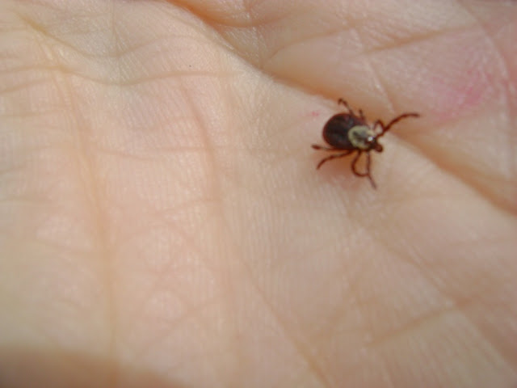
Trauma “Tick” Check
“Body awareness is critical for mediating the risks of vicarious trauma and burnout”-Babette Rothschild (2005)

Slide 42
Biblical Mindfulness Practice
(Mindfulness is a key strategy to combat all trauma)
I have found fa vor
In Your sight Lord
And You know me
By my name __
Exodus 33:17b

Slide 43
Resources!!!

Slide 44
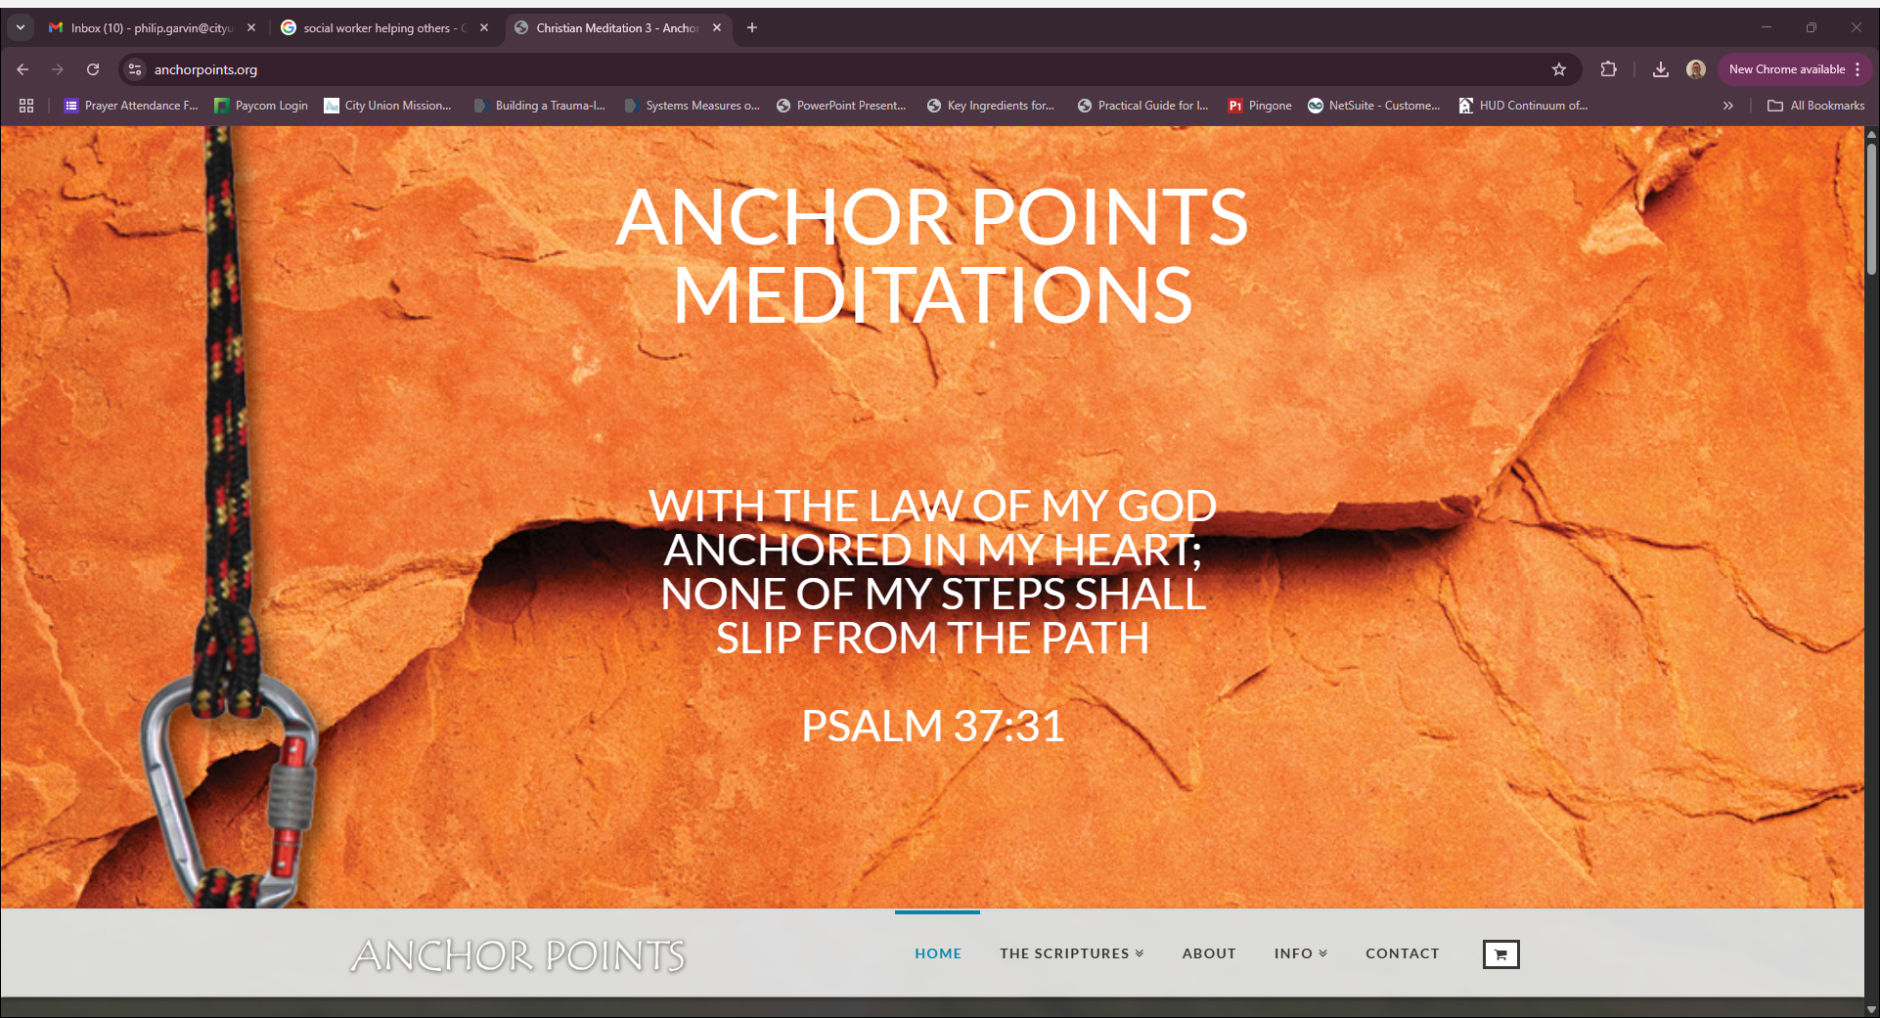
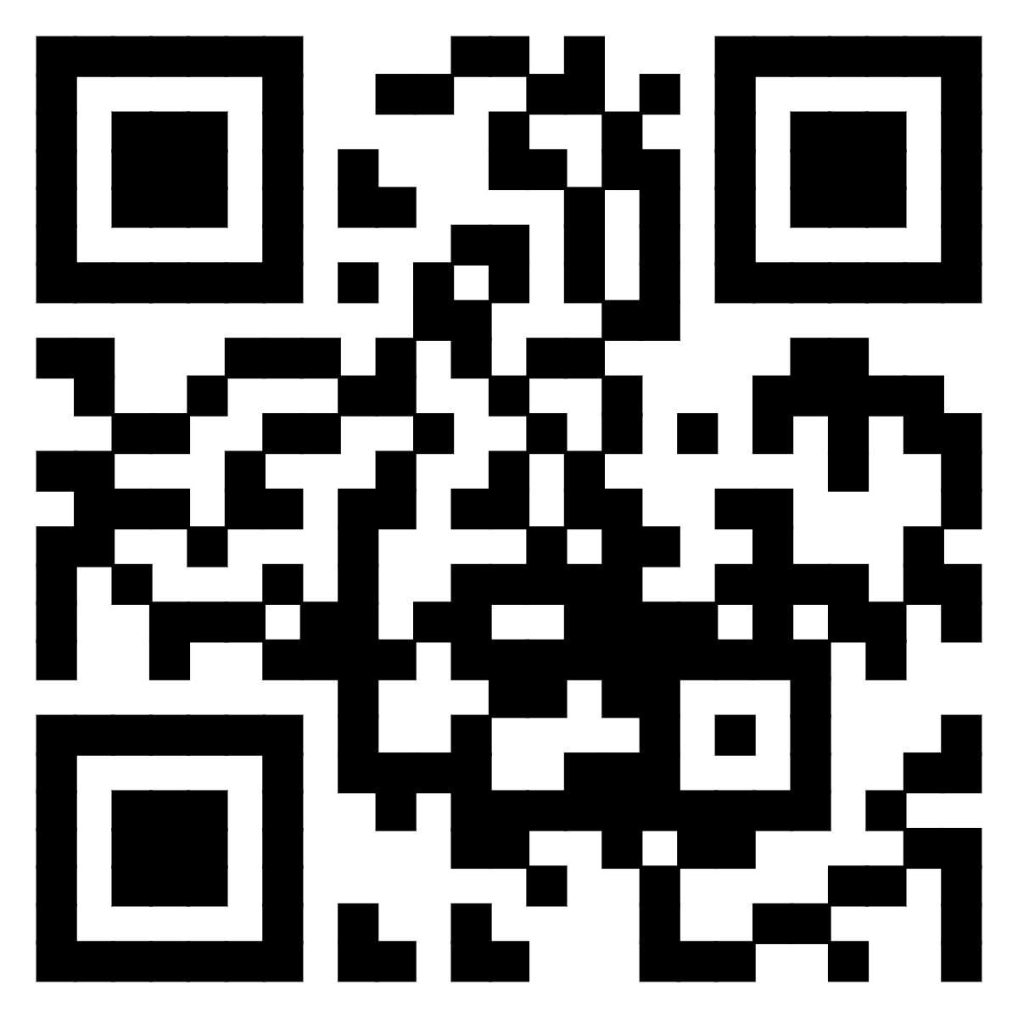
www.anchorpoints.org
Access Biblical meditations set to music for free!
QR Code

Slide 45
Resources: Secondary Trauma
McFarlane, Alexander, and Bessel van der Kolk. “Trauma and It’s Challenge to Society” (pp 24-46) in Traumatic Stress: The Effects of Overwhelming Experience on Mind, Body, and Society, New York, NY: Guildford Press, 1996.
Pearlman, Laurie Anne, and Karen Saakvitne. Trauma and the Therapist: Countertransference and Vicarious Traumatization in Psychotherapy with Incest Survivors. New York, NY: W. W. Norton, 1995.
Rothschild, Babette, and Marjorie Rand. Help For the Helper: The Psychophysiology of Compassion Fatigue and Vicarious Trauma. New York, NY: W. W. Norton, 2006.
Saakvitne, Karen W., and Laurie Anne Pearlman. Transforming the Pain: A Workbook of Vicarious Traumatization for Helping Professionals Who Work with Traumatized Clients. New York, NY: W. W. Norton, 1996.
Sawicki, Soraya M. Mental Health Workers’ Vicarious Trauma, Secondary Traumatic Stress, and Self Care. Richmond VA: DBC Publishing, 2019 (Dissertation Publication)
Steele, William. Reducing Compassion Fatigue, Secondary Traumatic Stress, and Burnout: A Trauma Sensitive Workbook. New York, NY: Routledge Press, 2020.

Slide 46
Resources: Organizational Culture
Baha, Mehmet. Creating Psychological Safety at Work: The Essential Guide to Boosting Team Performance. Monee, IL: Solution Folder Publishing, 2024.
Chapman, Gary, and Paul White. The Five Languages of Appreciation in the Workplace: Empowering Organizations by Encouraging People. Chicago, IL: Northfield Publishers, 2019.
Edmundson, Amy. The Fearless Organization: Creating Psychological Safety in the Workplace for Learning, Innovation, and Growth. Hoboken, NJ: Wiley and Sons, 2019.
Howard, Kerry. How to Heal a Workplace: Tackle Trauma, Foster Psychological Safety, and Boost Happiness at Work. Melbourne, Australia: John Wiley and Sons, 2023.
Radecki, Dan, Leoni Hull, Jennifer McCusker, and Christopher Ancona. Psychological Safety: The Key to Happy, High-Performing People and Teams. Monee, IL: Red Hill Publishing, 2021.

Slide 47
Resources: Trauma Treatment Theory
Gingrich, Heather Davediuk. Restoring the Shattered Self: A Christian Counselor’s Guide to Complex Trauma. Downer’s Grove, IL: Intervarsity Press, 2020.
Gingrich, Heather Davediuk, Fred C. Gingrich (editors). Treating Trauma in Christian Counseling. Downer’s Grove, IL: Intervarsity Press, 2017.
Herman, Judith. Trauma and Recovery: The Aftermath of Violence. New York, NY: Basic Books, 2022. (Trauma treatment theory/counseling)
Levine, Peter A. Waking the Tiger: Healing Trauma. Berkeley, CA: North Atlantic Books, 1997.
Rothschild, Babbette. The Body Remembers: The Psychophysiology of Trauma and Trauma Treatment. New York, NY: W. W. Norton & Company, 2000.
_____. Revolutionizing Trauma Treatment: Stabilization, Safety, & Nervous System Balance. New York, NY: W. W. Norton, 2021
van der Kolk, Bessel. The Body Keeps the Score: Brain, Mind, and Body in the Healing of Trauma. New York, NY: Penguin, 2014.

Slide 48
Resources: Self Guided Help
Frank, Britt. The Science of Stuck: Breaking Through Inertia to Find Your Path Forward. New York, NY: Tarcher-Perigree of Penguin Random House, 2022
Gilbert-Elliot, Trudy. Healing Secondary Trauma: Proven Strategies for Caregivers and Professionals to Manage Stress, Anxiety, and Compassion Fatigue. Emeryville, CA: Rock Ridge Press, 2020.
Hiser Bethany Dearborn. From Burned Out to Beloved: Soul Care for Wounded Healers. Downers Grove, IL: Intervarsity Press, 2020.
Jantz, Gregory, and Keith Wall. Triumph Over Trauma: Find Healing and Wholeness from Past Pain. Grand Rapids, MI: Revell, 2023.
Wolynn, Mark. It Didn’t Start With You: How Inherited Family Trauma Shapes Who We Are and How to End the Cycle. New York, NY: Penguin, 2016.

Slide 49
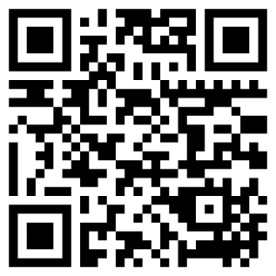
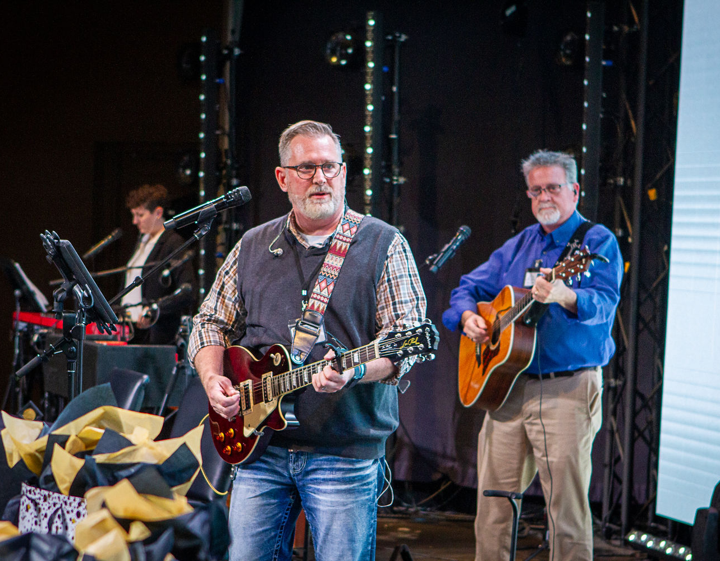
Contact me: philip.garvin@cityunionmission.org

Slide 50
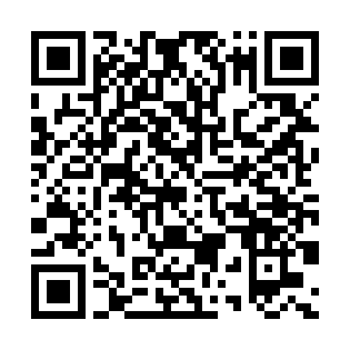

Don’t forget to download the app!

