Slide 1
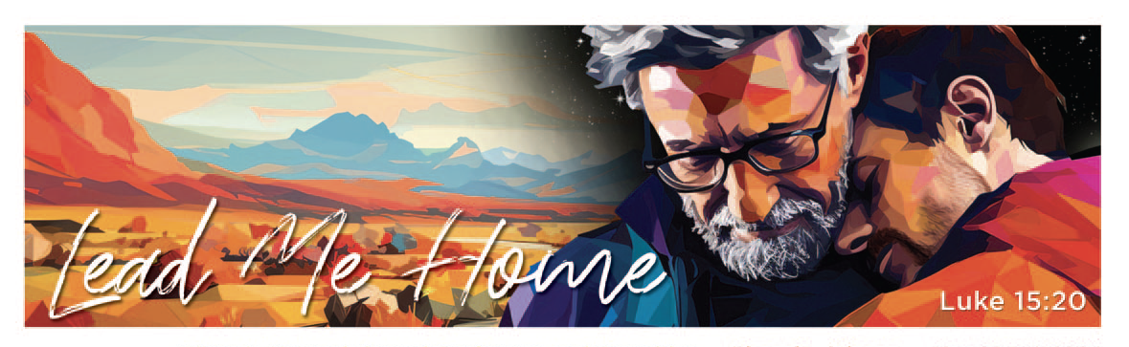


Winning Government Grants Without Losing Your Mission
Presenter: Sarah Kerr
Assistant Director of Grants, Helping Up Mission

Slide 2

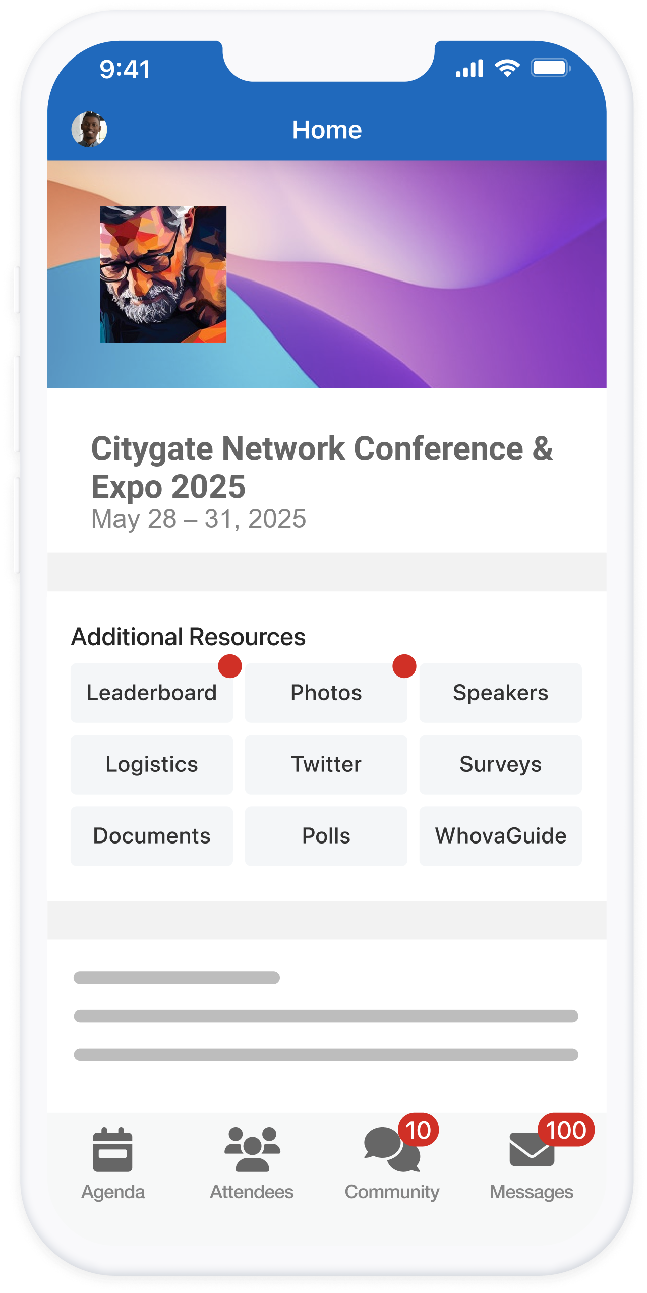
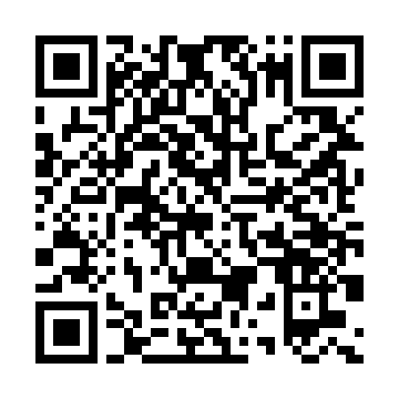

step #1:
Download
Whova + Find Event
step #2:
Click ‘Agenda’

Slide 3
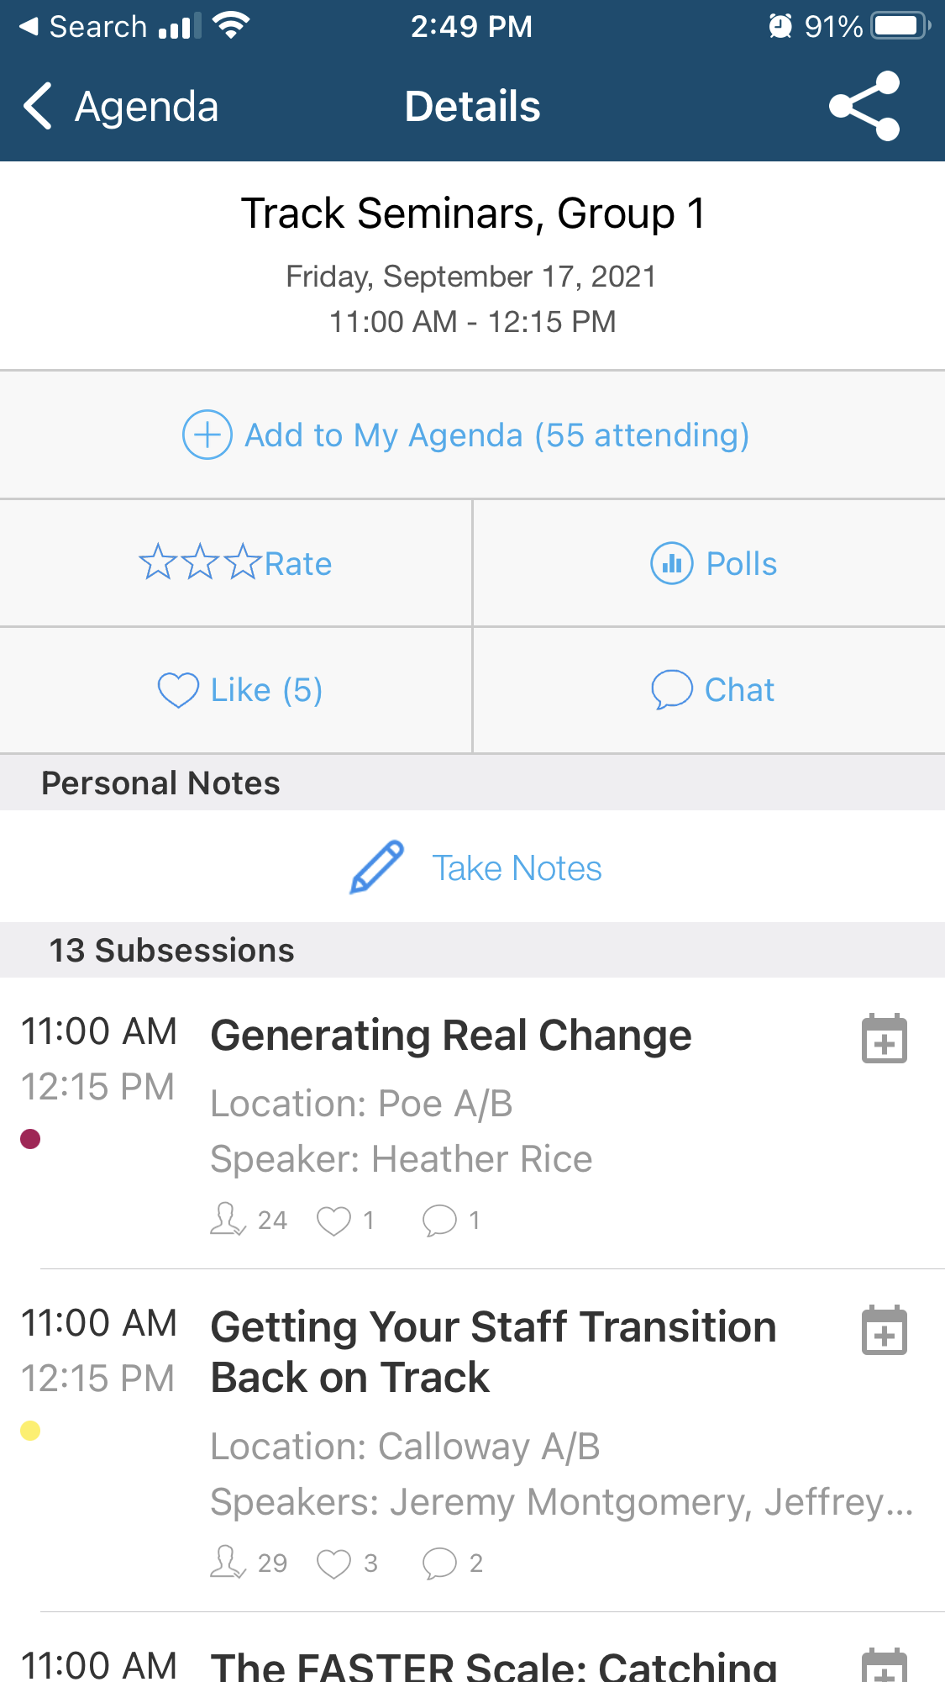

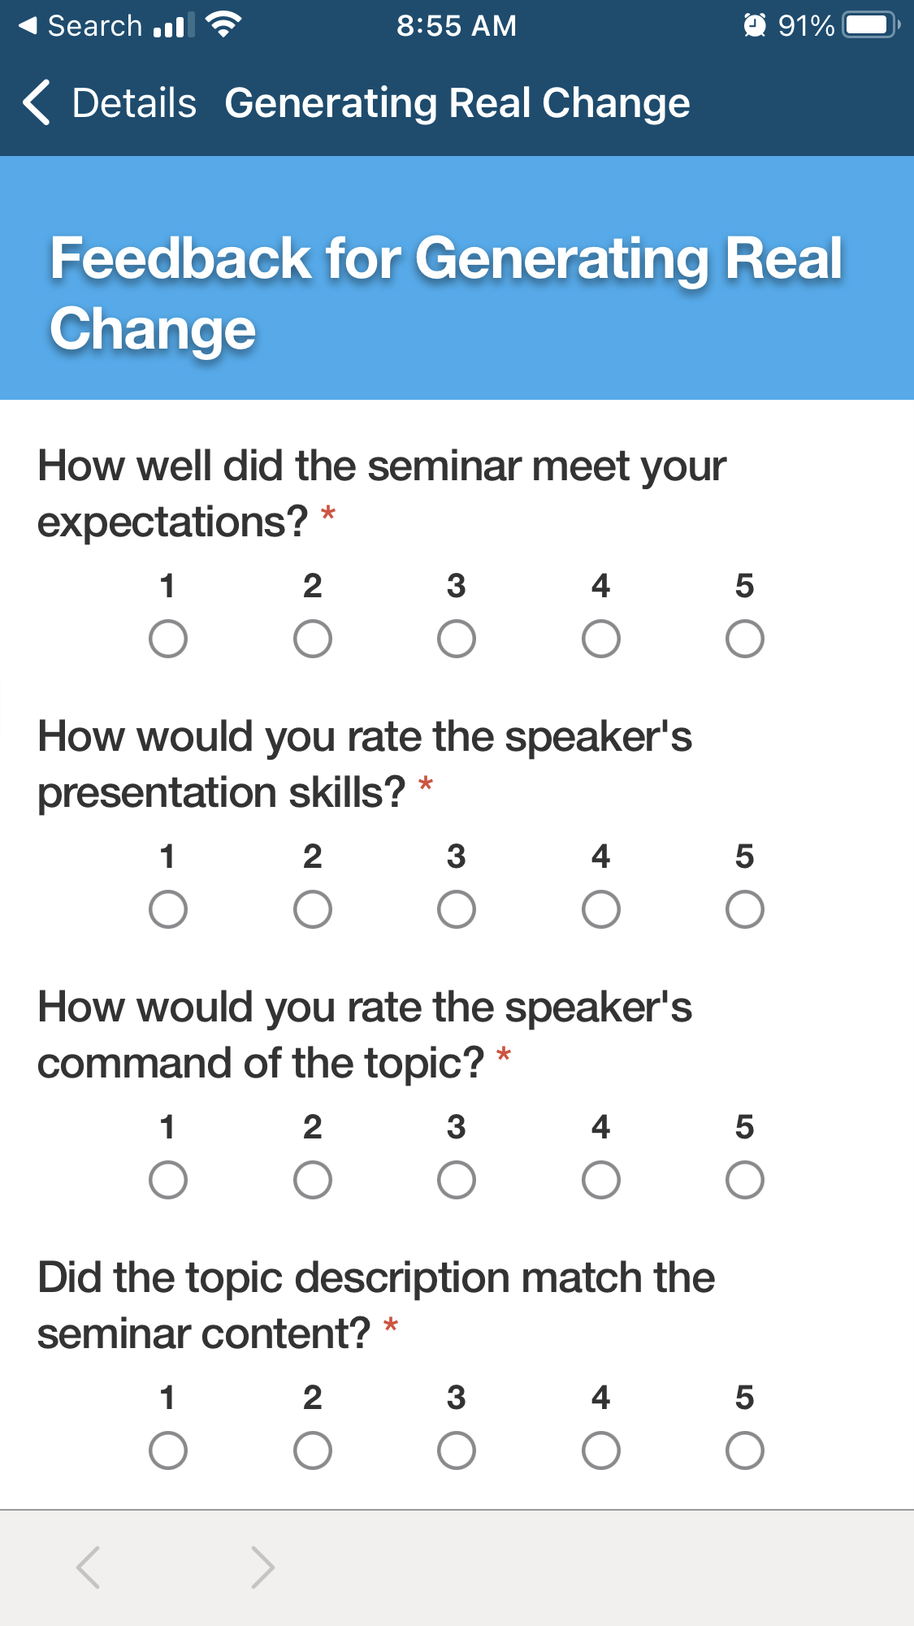
step #3:
Open This Track
Seminars Group +
Find Seminar
step #4:
Select ‘Rate’ then Answer Questions & Submit!

Slide 4
Winning Government Grants Without Losing Your Mission
Presenter: Sarah Kerr
Assistant Director of Grants, Helping Up Mission

Slide 5
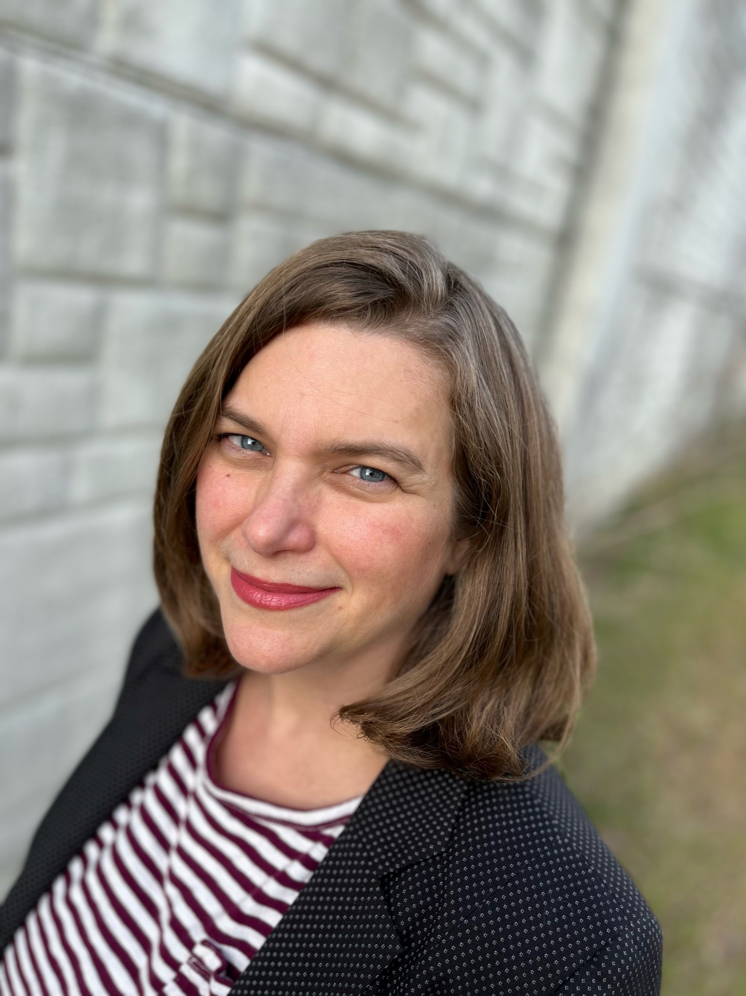
Sarah Kerr, Assistant Director of Grants

Slide 6

Where we were?
In 2015, we had about $150k in all grants and $0 government grants…
…in FY2026, our grants income is estimated to be about $1.5MM with about $1MM estimated gov’t funding.
Notes:
In an era when household giving is flat or decreasing, grants are a pragmatic philanthropic resource. They do take a bit of work but there can be significant benefits. You might even have fun!

Slide 7
Agenda
3 Main Sections
Grants Management Process
Securing Government Grants
Workshop It: Proposal Components
Added Bonus: Resource Pages with Links
Notes:
I’ve broken this training out into three parts with a workshop component. I’ll try to get a read on the room to see where we are in our grant-seeking program and adjust if

Slide 8
Grants Management
Process

Slide 9
Grants Management Process
Main Points:
What is a Grant?
Grants vs. (Other) Major Gifts
Grant Lifecycle
Push Me / Pull You – Proposal Development & Program Design

Slide 10

What is a grant?
A sum of money (or GIK) by an entity* for a particular purpose
*Entity = family foundation, corporate foundation, government entity, church
Written request
Usually a defined process (RFP/NOFO/RFA/NOFA) but sometimes not
Application follows purpose of funder
Could be a sub-grant
Requires specific outputs, outcomes and impact
Compliance: Reporting

Slide 11
Grants vs. (Other) Major Gifts
Grants | VS | Other Major Gifts
Program restriction/ what you spend $ on |  | Very defined by nonprofit
Reporting – detailed & Donor driven |  | High level
Reimbursable – paid out after work |  | Given ahead of time for future work
Requirement Driven but Relationships Matter! |  | Relationship, Relationship, Relationship
Long cycle – 3-18 months from request |  | Shorter – 1-3 months

Slide 12
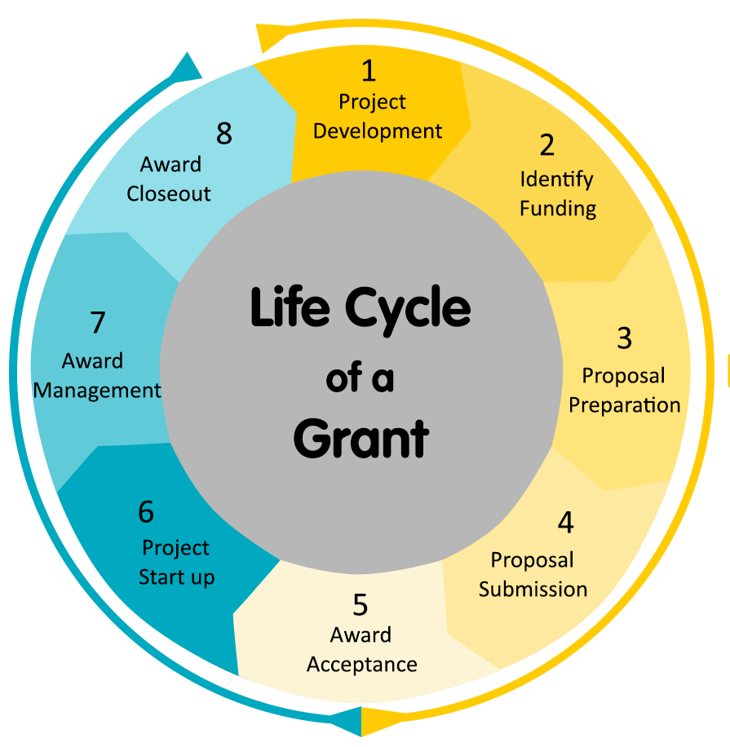
Grant Lifecycle
Credit: https://kyimages.kyinbridges.com/1667100311221.png
Notes:
Credit: https://kyimages.kyinbridges.com/1667100311221.png

Slide 13
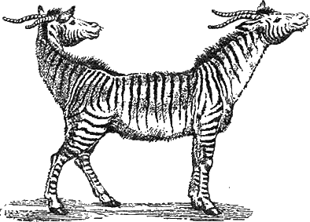
Proposal Development & Program Design
Push Me / Pull You:
As fundraisers, we want to know Program needs and respond.
Program managers are the ones that define their projects goals, outputs, outcomes, and how they will implement their program
Grants staff can help define types of data, clarify activities and timelines, but we do not create programs to meet a grant opportunity.
We may ask, “Are you doing X type of work? Or, do you want to?”
Photo credit: https://bit.ly/PushMePullMe
Notes:
Credit Image: https://th.bing.com/th/id/R.e7d733d2b31aa7abf8b35de4c4bf81ce?rik=OaHLaKJP05%2fqEQ&riu=http%3a%2f%2fpandius.com%2f18184988614_75337f02cd_o.png&ehk=48bh6TNawWOiABAiHWHdK%2bmPiqJ%2fqdAVvRq1DwcQmNc%3d&risl=&pid=ImgRaw&r=0

Slide 14
Government Grants
Notes:
Raise your hand if you have applied for government grants?
Keep them up if you have won and implemented government grants?
Keep them up if you thought the process was fun!

Slide 15
Government Grants
Main Points:
Some History & Precedent
Barriers – Real & Perceived
The Tooth of It: A Case Study
Guess Who? At Team Approach
What will Government Grants Fund?
And what will they not?
Pitfalls and Grant Readiness
Wrapping it Up -- Reporting

Slide 16
Some History
“The indispensable and transforming work of faith-based and other charitable service groups must be encouraged. Government cannot be replaced by charities, but it can and should welcome them as partners. We must heed the growing consensus across America that successful government social programs work in fruitful partnership with community-serving and faith-based organizations.”
- President George W. Bush
Notes:
https://georgewbush-whitehouse.archives.gov/government/fbci/guidance_document_01-06.pdf

Slide 17
Barriers – Real & Perceived
Can Faith-Based Organizations, particularly Christian organizations that have statements of faith and hiring limitations based on their faith, secure government funding?
What are some of the barriers?
Notes:
You are not alone in asking this question. Just yesterday, the President of Grants Station, Alice Ruhnke, led a training for $69 per person of essentially the same title of the one that I am presenting today, focusing on Federal grants. Funding for Faith-Based Organizations | GrantStation
Ask for audience participation to offer some barriers they have experienced or perceive.
Affirm that HUM experienced some of the same but we’ll share a case study on our first government program grant.

Slide 18
The Tooth of It: A Case Study
Main Points:
Awareness / Education
Opportunity: Funding Opportunity Announced
The Need: more $$ to serve more clients with dental needs
Project Management & Leadership Buy-in
Program History: Great outcomes ALREADY documented
  Increased Days In Program
  Employment
  Self Esteem
Strong Program and Finance Partners

Slide 19
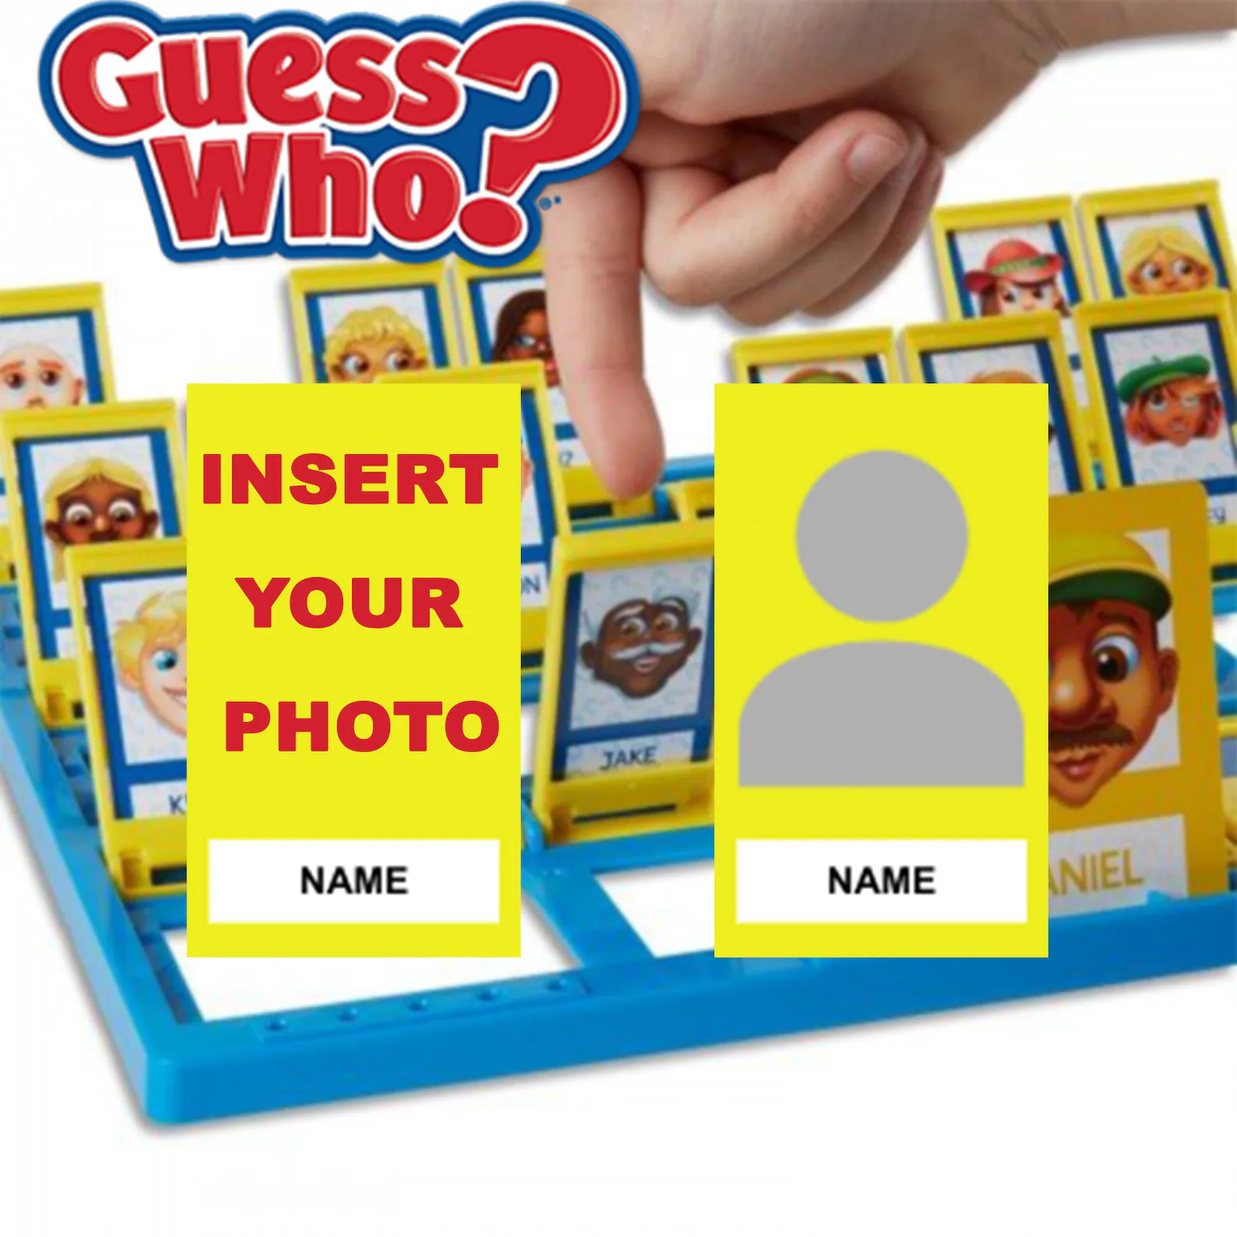
Guess Who? A Team Approach
Main leadership for Gov’t Grants
Lead Proposal Writer
Lead Report Writer
Finance – Accountant
Program Director/ Manager
CEO?

Slide 20
Bureaucrats are people, too
Relationships, Relationships, Relationships!
Pick up the PHONE

Slide 21

What will Gov’t Grants Fund?
Main Points:
Restricted Grants
Stages of a Program Development
New or Expanded Programs
Deep and Wide
Staff – Particularly Peers
Discrete Activities
  Equipment
  Staff Training
  12 Step Materials
  Transportation
Notes:
Program Development
Pre-planning / Consultant
Pilot
New Expansion / Scaling
Expanding to Population (Women, Children)
“Operational” / Ongoing

Slide 22

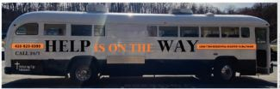




This Photo by Unknown Author is licensed under CC BY-NC
This Photo by Unknown Author is licensed under CC BY-SA
Notes:
Programs and Projects we’ve had funded by gov’t grants:

Slide 23

And What will they not?
General Operations
Your Chaplain or Spiritual Life Director
Administrative Staff Directly (vs. Indirect Costs)
Ongoing Programs (maybe?)
Grants Staff
Bibles (probably not)
This Photo by Unknown Author is licensed under CC BY-NC
Notes:
Program Development
Pre-planning / Consultant
Pilot
New Expansion / Scaling
Expanding to Population (Women, Children)
“Operational” / Ongoing

Slide 24
Avoiding Pitfalls & Grant Readiness
Federal Grants & Sub-Awards*
SAM.gov and UEI Registration
“Supplanting Funding” – taking the place of other government funding.
The Kitchen Sink Budget
Reimbursements
DON’T “Go Big or Go Home”
Reporting burden
*Contracts – another funding source

Slide 25
Reporting
Credit: https://kyimages.kyinbridges.com/1667100311221.png
Notes:
Credit: https://kyimages.kyinbridges.com/1667100311221.png

Slide 26
Capacity Building for Gov’t Grants
Academia
Government
Candid
Grants Professional Association – local chapters
  Baltimore is hosting the Grant Summit in October!
Associated Fundraising Professionals

Slide 27
Workshop It: Grant Application Components

Slide 28
Grant Proposal Components
Main Components:
Logic Model w/ SMART Goals
Budget Table – Excel, Spreadsheet, Google Sheets
Budget Narrative with Justification
Proposal Narrative
  Evidence of Need
  Evidenced Based Practices
  Outcomes

Slide 29

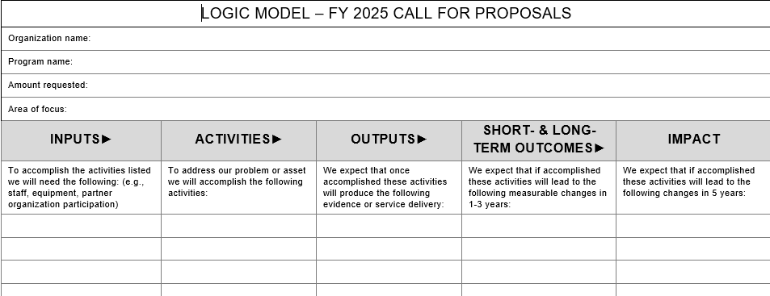
Logic Model
SMART GOALS
Pro Tip: You will need to set target numbers to be competitive!
Notes:
Sample Logic Model from Maryland Community Health Resources Commission Request For Application 2025: Maryland Department of Health notices

Slide 30
Budgets
Main Components:
Budget Table – Excel, Spreadsheet, Google Sheets
Budget Narrative with Justification

Slide 31
Proposal Narrative
Main Components:
Problem – Evidence of Need
Solution – Evidenced Based Practices
Outputs and Outcomes Data – HUM Tools

Slide 32
Resources
skerr@helpingup.org
410-316-6162

Slide 33
Mining for Gold in Gov’t
Grants Research
https://www.opioidsettlementtracker.com/communitygranttracker
https://www.grants.gov/
Federal Tracking Changes: Tracking Federal Actions Impacting the Nonprofit Sector | GrantStation
SAMHSA outreach: Engagement@samhsa.hhs.gov
HUD: https://www.hud.gov/hud-partners/grants-info-funding-opps
State: https://grantstation.com/search/state-grants/home
https://georgewbush-whitehouse.archives.gov/government/fbci/guidance_document_01-06.pdf

Slide 34
Resources – General Grants
Grants Professional Association: https://grantprofessionals.org/
  Grant Contractors
Foundation Search: https://www.foundationsearch.com/
Candid Foundation Directory Online (access through library): https://fconline.foundationcenter.org/
Guidestar: https://www.guidestar.org/
Philanthropy News Digest: https://philanthropynewsdigest.org/rfps

Slide 35
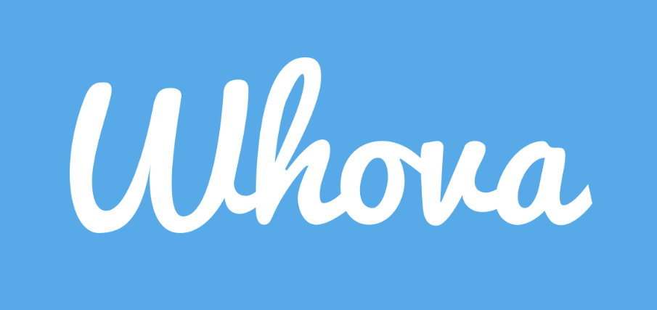
Don’t forget to download the app!

