Slide 1



Setting Your Board Up for Success

Slide 2
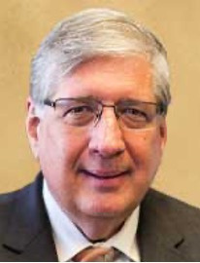


Welcome:
Ripple Team Presenters
HERB
SMITH
Los Angeles Mission
REID
LEHMAN
Miracle Hill Ministries
PENNY
KIEVET
City Rescue Mission Jacksonville

Slide 3

What We Will Share Today
What and Why of Ripple Effect Board Training
  Policy Board Governance Model, Best Practices
Relationships Matter Most – Board, CEO & Staff
  THE HATS!
Clear Roles, Responsibilities & Reporting
Who’s done it with what Impact
  Your chance to ask our Panel of 3 CEO’s
Your Mission if you choose to accept it is:
  5 ACTIONABLE KEYS FOR SUCCESS

Slide 4
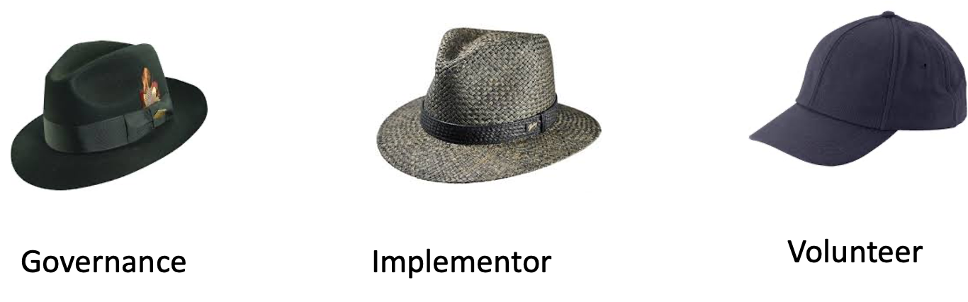
The Three Hats of Board Members
Credit: The Andringa Group

Slide 5
Citygate’s Ripple Effect Training Program
Ripple 2.0
We offer an Onsite or Video Training in Six Modules:
  Good Governance
  Effective Board Members
  Board Policy Manual
  Strategy
  The Board and Money
  Good Decision Making
Coaching is a must for success!

Slide 6



THE HIGHEST CALLING
OF THE BOARD IS TO DETERMINE
THE ORGANIZATION’S ENDS
(mission and strategic priorities)
Ends
What Good? (results)
For Whom? (recipients)
At What Cost? (relative worth)
Means
Methods
Activities
Programs
Practices
All aspects of the Policy Governance® model mentioned in this presentation are properly attributed to its designer, Dr. John Carver.

Slide 7

Is it always clear whether it’s a
Board decision or
CEO decision?
Is it a Board issue?
❑ What’s the difference between Board/Staff issues?
Is it an important decision?
❑ How do you know what’s important?
❑ Does the CEO not make any important decisions?
Is it something the Board did not expect?
❑ Can no unexpected decision be made without Board involvement?

Slide 8

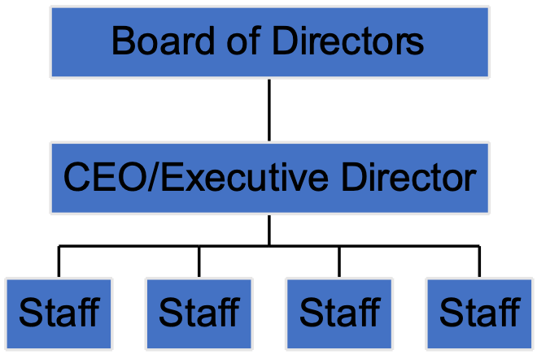
The Board Speaks with One Voice

Slide 9
Board Delegates Authority with Precision
BOARD DECISIONS ARE STATED PRIMARILY AS POLICIES
Policies should be consistent and coherent
Policies should be succinct and reflect values of the Board
Distinguish between Board policies and Staff policies
Values
Enduring Principles
Definitions of Prudence
Safeguards
Strategic Imperatives

Slide 10
WHICH DECISIONS HAVE TO
COME TO THE BOARD?
The CEO may do whatever is needed to achieve your mission,
lead operations effectively and achieve your strategic objectives.
Except the CEO shall not:
  Allow any organizational circumstance which is unlawful, imprudent,
  unbiblical, or unethical, and shall not:
    Allow clients to experience a lack of safety, dignity, confidentiality or privacy.
    Allow staff to lack clarity or experience conditions that are unfair or unsafe.
    Allow budgeting that risks fiscal jeopardy or that harms multi-year solvency.
    Allow fiscal instability in daily operations.
    Allow shabby, dirty facilities or assets to be inadequately maintained or risked.
    Allow programs that are ineffective, or that lack compassion, evangelism, and discipleship.

Slide 11
Strategic Leadership is Inherent
Strategic Leadership
  Board focuses on strategic issues
    Mission, Vision, Values
    Adaptive Strategic Priorities
    Future Focused
  Operational details belong to the Executive Director
Who Does What?
  Strategic Priorities: Board or Staff?
  Strategic Priorities Goals: Board or Staff?
  Operational Planning: Board or Staff?
By Concentrating on Ends and long-term goals, the board provides strategic leadership!
  Red Card/Green Card
  Multi-voting
  The Dutch Auction

Slide 12
Transparency and Trust are Established
Policy Governance Emphasizes Transparency
  The Board defines expectations
  The Board demands relevant performance information (Monitoring Reports)
Stakeholders trust:
  Organizations that adhere to clear policies
  Organizations that have ethical standards

Slide 13
Evaluation and Accountability are closely monitored
The Board Evaluates…
  …performance based on pre-stated expectations.
  …themselves.
The Question is Simple:
“Have our expectations been met?”
Rigorous Evaluation…
…ensures alignment with your mission’s mission

Slide 14
Our Panel
  Candace Gregory
    Open Door Mission, Omaha
  Jerrel Gilliam
    Light of Life Mission, Pittsburgh
  Kim Cook
    Bread of Life Mission, Seattle

Slide 15


Five Keys for Success
Participate in Ripple Effect
Board Policy Manual – Create one if you don’t have one, or improve the one you have.
Sign up for a free Bylaws Review
Clarify expectations of Board Members, with a focus on the three different hats each of them wears
Can you get agreement that the Chair’s job is leading the board effectively, and the CEO’s job is leading the ministry effectively? The CEO works for the Board, not for the Board Chair.

