Slide 1

Human Resources Bootcamp
For blended, small and emerging teams
Presenter: Ashley Roose
Vice President, Human Resources ~ Open Door Mission, Rochester, NY

Slide 2

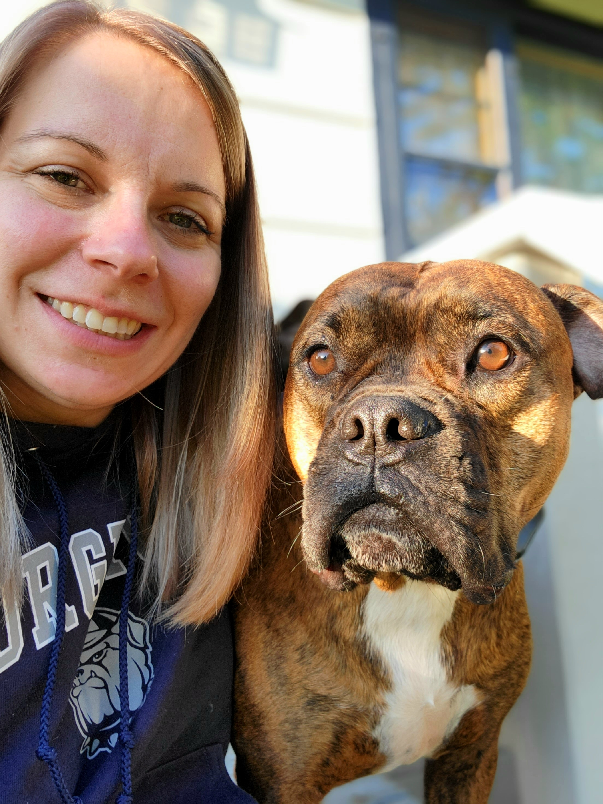
Meet Ashley
9 Years Rescue Mission
Vice President, Human Resources (2022 )
Immediate Past President, Genesee Chapter Valley of SHRM (2021-2024)
Former ministry leader ~ Volunteer Coordinator and Youth Leader
BA, Criminal Justice ~ Canisius College
MS, Strategic Leadership ~ Roberts Wesleyan College
SHRM-CP
1x dog foster
Star Trek > Star Wars

Slide 3
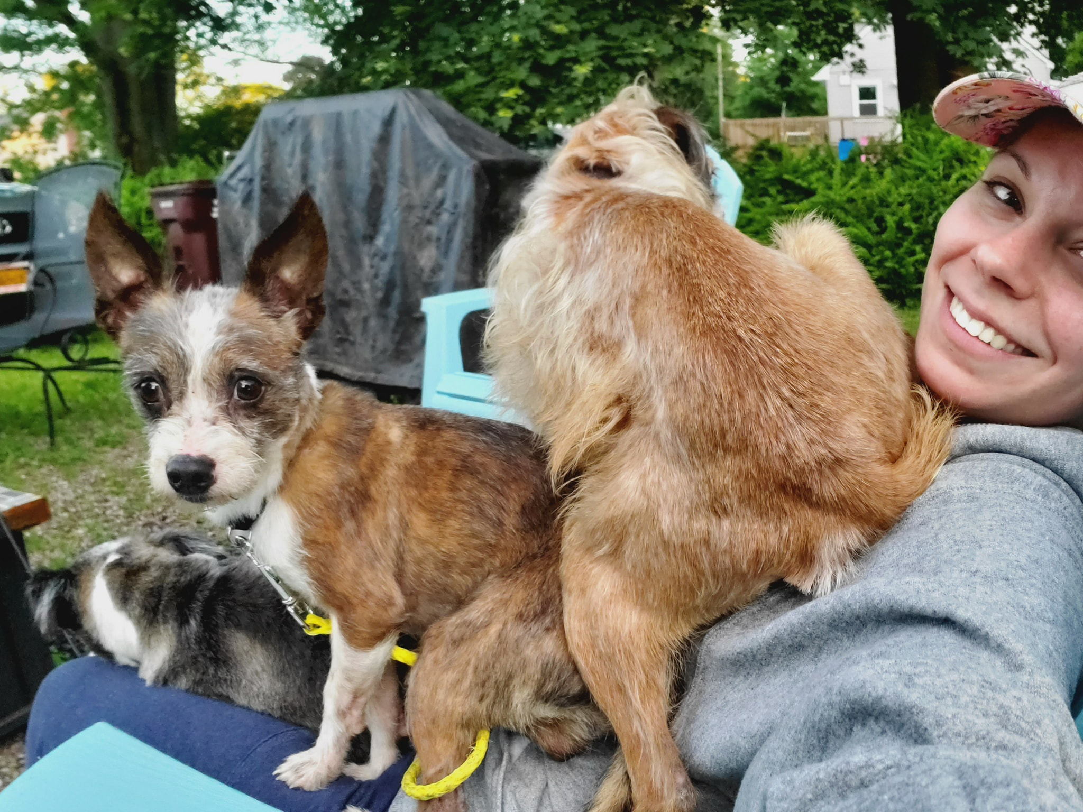
Meet Ashley
9 Years Rescue Mission
Vice President, Human Resources (2022 )
Immediate Past President, Genesee Chapter Valley of SHRM (2021-2024)
Former ministry leader ~ Volunteer Coordinator and Youth Leader
BA, Criminal Justice ~ Canisius College
MS, Strategic Leadership ~ Roberts Wesleyan College
SHRM-CP
1x dog foster
Star Trek > Star Wars

Slide 4
1 Peter 5:2-3
Be Shephard's of God’s flock that is under your care, watching over them – not because you must, but because you are willing, as God wants you to be; not pursuing dishonest gain, but eager to serve; not lords over those entrusted to you, but being examples to the flock.

Slide 5
Today’s Agenda
The Strategic Role of HR
Competencies Deep Dive
HR Department Models
Q&A

Slide 6
The Strategic Role of Human Resources

Slide 7
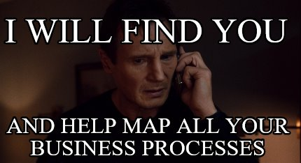

The 2 P’s
Process
People

Slide 8
Aligning Business Strategy to HR Strategy
Vision
What does the future look like?
Mission
Where are we going?
Business Strategy
How are we going to get there?
Business Plan
What are the numbers over the next X years?
Operating Plan
What are the current year’s numbers?
You are here!
HR Strategy: Business focused, individually centered (Paul Kearns)

Slide 9
Aligning Business Strategy to HR Strategy
Vision
What does the future look like?
Mission
Where are we going?
Business Strategy
How are we going to get there?
HR Strategy
How do HR goals align?

Slide 10
Aligning Business Strategy to HR Strategy
Vision
Through faith and community, create transformational moments for everyone who experiences Open Door Mission.
Mission
Provide the spiritual, physical, and emotional needs of the impoverished men, women and children in Rochester, NY
Business Strategy
To address Rochester’s childhood poverty, expand services to include transitional housing for women and their children
HR Strategy
Increased staffing
Additional technology
Multi-site considerations: training, time keeping, meals, scheduling

Slide 11
Finding the Right People
-Culture fit and values alignment
-Competency based hiring
-Creating a strong onboarding experience
-Continuous feedback and improvement
-Collaboration and networking

Slide 12
Competencies Deep Dive

Slide 13
Behavioral ABCD’s
Active Listening
Business Acumen
Communication
Delegation

Slide 14
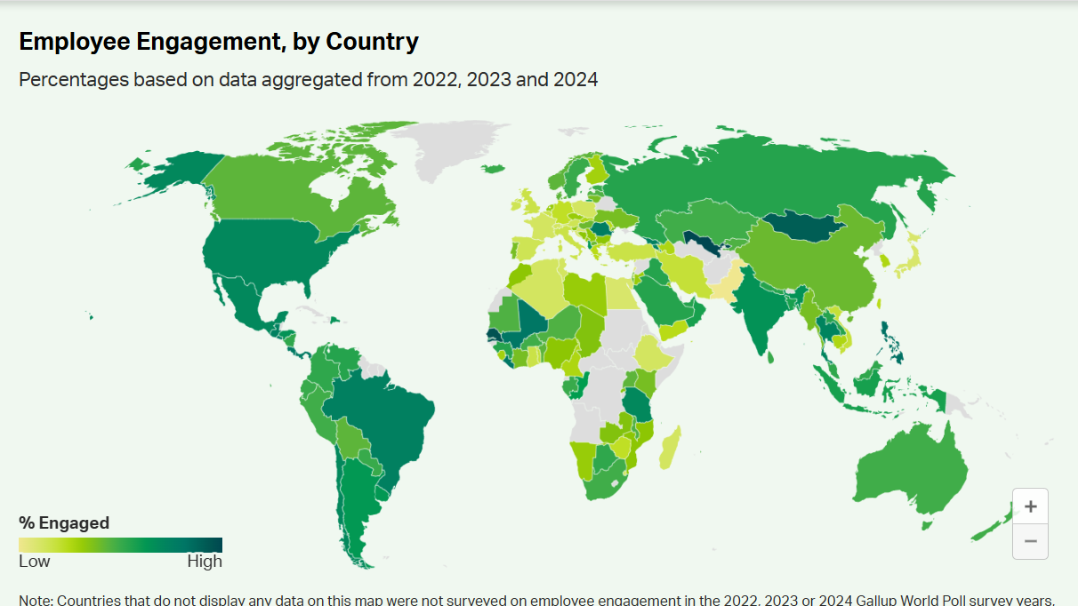
United States
33% Engagement

Slide 15
Active Listening
What is it?
Cognitive
Emotional
Behavioral
Listening Styles:
Task oriented listener
Analytical listener
Relational listener
Critical listener
https://hbr.org/2024/01/what-is-active-listening

Slide 16
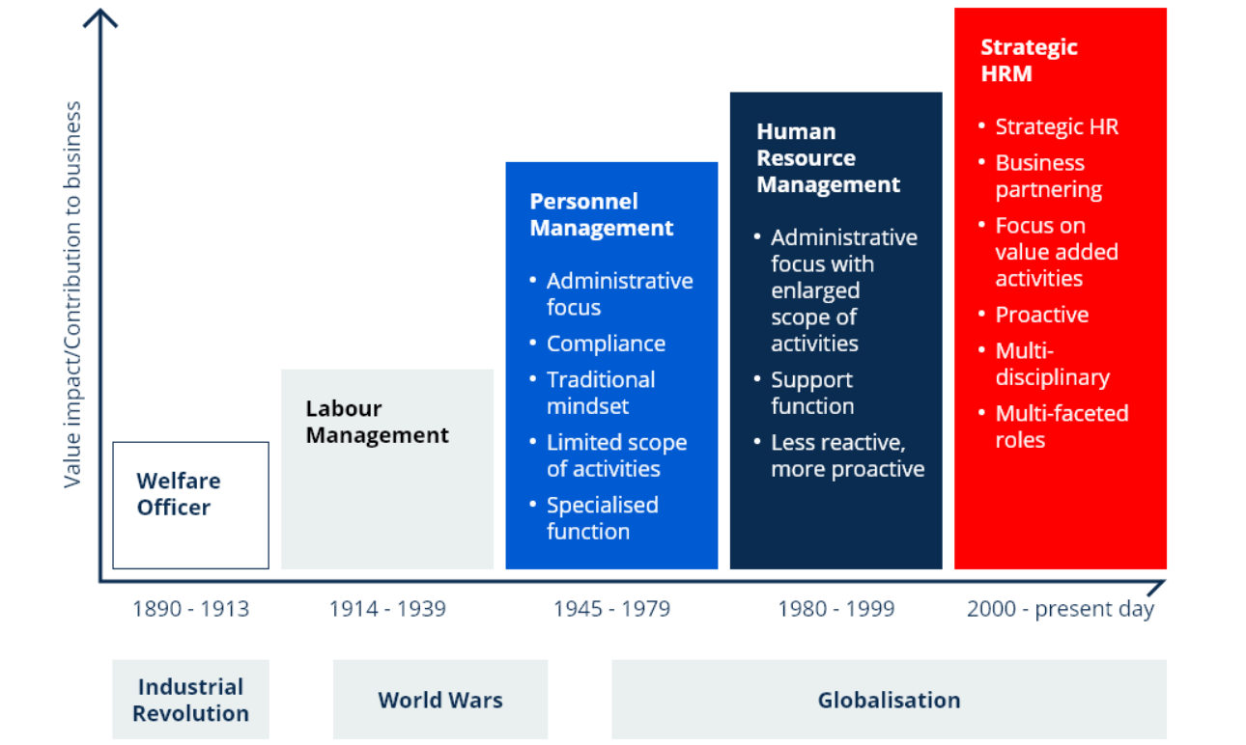
https://online.kcl.ac.uk/blog/the-evolution-of-global-hrm

Slide 17
Business Acumen
It is the understanding of how the business operates. Strategic HR evolves beyond the regulatory, transactional, and reactive tasks, and aligns its goals to move the business goals forward.
Who is wise and understanding among you? By his good conduct let him show his work in the meekness of wisdom.
~James 3:13

Slide 18
SWOT Analysis
Future State
Strength
Weakness
Opportunities
Threats

Slide 19
GAP Analysis
Current State
Action Plan:
Steps that bridge the Gap
GAP
Future State

Slide 20
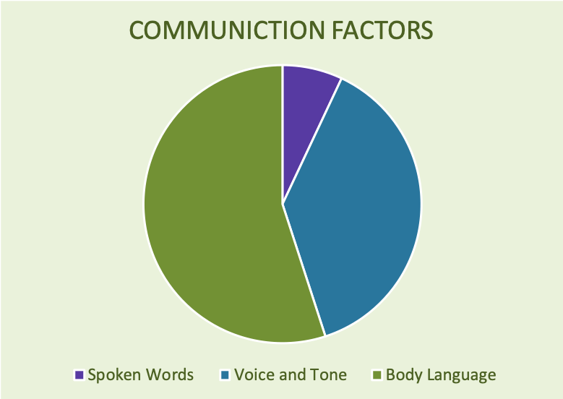
https://worldofwork.io/2019/07/mehrabians-7-38-55-communication-model/

Slide 21
Communication
Maintain eye contact
Use appropriate hand gestures
Facial expressions
Eye contact
Body Language
https://conflict-resolution-training.com/blog/nonverbal-communication-workplace/#:~:text=Mastering%20non%2Dverbal%20communication%20in,you%20interact%20with%20your%20colleagues.

Slide 22


Slide 23
Delegation & Network
Identify personal and/or team strength
Strategic focus – recognize what you should do
Identify your internal and external stakeholders
Foster collaborative relationships – including professional partners
Delegate appropriately!

Slide 24
Technical Competencies
Employee File Management
Recruiting & Onboarding
Compensation & Benefits
Compliance
Workplace Safety
Handbook & Policies

Slide 25
Compliance
Internal Controls
Mandated Compliance
You are here!

Slide 26
HR Start-Up
Payroll systems & administration
Organization hierarchy
Benefit plans
Compliance posters

Slide 27
Growth Benchmarks
All Employees | W2 Reporting FLSA Overtime
11+ Employees | OSHA Reporting Basic Safety
15+ Employees | Title VII discrimination Title III of CPPA – restrictions on wage garnishments Pregnancy Discrimination Americans with Disability Act (ADA) Employee documentation
20+ Employees | Age Discrimination Medicare as primary insurance for employees 65+ Consider Safety Committees
50+ Employees | Family Medical Leave Act (FMLA) Affordable Care Act (ACA) Standardize PTO/Vacation, if not previously provided
100+ Employees | EEOC Reporting

Slide 28
Handbook & Policies
What it’s not:
Policy and procedure manual
Antiquity
HR manual
Must:
BRAND focused and engaging
Includes internal controls and mandated compliance
Accessible
Best practices:
Scalable
Flexible
Mindful of position specific expectations
LEGAL REVIEW

Slide 29
Recruiting & Onboarding
Staffing plan and budget
Job descriptions - Identify key competencies of the position
Pay structure & Benefits
Solidify your brand
Onboarding experience
Retention
Continuous learning and development
Continuous feedback and improvement

Slide 30
Compensation & Benefits
Understand the overall budget
How does this connect to business strategy
Compare responsibilities not titles
Partnerships
Research

Slide 31
Employee File Management
Organize – function and compliance
Version control
Access Permissions
Regular Audits
Training and communication

Slide 32
Workplace Safety
Align with business purpose
Compliance with applicable regulations
Risk assessment and prevention
Training and awareness
Mental health and wellbeing

Slide 33
HR Department Models

Slide 34
Blended Teams
Key Characteristics: Versality and collaboration
Benefits: Agile and innovative problem solving
Challenges: Role ambiguity and workload
Common titles: Office Managers, Administrative Assistants, Executive Assistants, and Finance or Operation Managers

Slide 35
Job Analysis
% of Time | Activities | Tasks | Frequency | Health | Existing Support | Delegation | Outsource/Relcoate
50% | Reception | Answer phones, greet public | 4-6 hours/day | OK | - | Vocational | -
>10% | Recruiting | Job posting, screening | 4 hours/week | Ok | - | - | Recruiting Company
>10% | Recruiting | Interviewing, Job Offers | 2 hours/week | Good | - | - | -
>10% | Onboarding | Tech, Training, Paperwork | 16 hours/month | Good | Management | - | -
25% | Pay & Benefits | Timesheets, benefit administration, claims | 10 hours/week | Poor | - | - | Finance Department
30% | Exec Assist | Scheduling, Coordination, Meetings | 3 hours/day | Ok | - | - | -
>1% | Insurance | Application, Invoice | Annually | Good |  |  | Ops Department

Slide 36
Relationships
Influence
Effective Communication
Leverage Expertise
Demonstrate Value
Negotiation
Continuous Learning
Authority
https://www.linkedin.com/pulse/power-influence-without-authority-unrealized-superpower-hr-xweoc/
https://www.forbes.com/councils/forbeshumanresourcescouncil/2018/11/14/influence-not-authority-shows-solid-leadership/

Slide 37
Any method of negotiation may be fairly judged by three criteria: It should produce a wise agreement if agreement is possible. It should be efficient. And it should improve or at least not damage the relationship between the parties.
-Roger Fisher & William Ury, “Getting to Yes: Negotiating Agreement Without Giving In”

Slide 38
Department of 1
Key Characteristics: Focused expertise and adaptability
Benefits: Enhanced focus (focus on strategic initiatives that drive business success) and flexibility (embrace outsourcing to avoid being bogged down in day to day)
Challenges: Workload management and skill gaps
Common Titles: HR Coordinator, HR Generalist, HR Manager

Slide 39
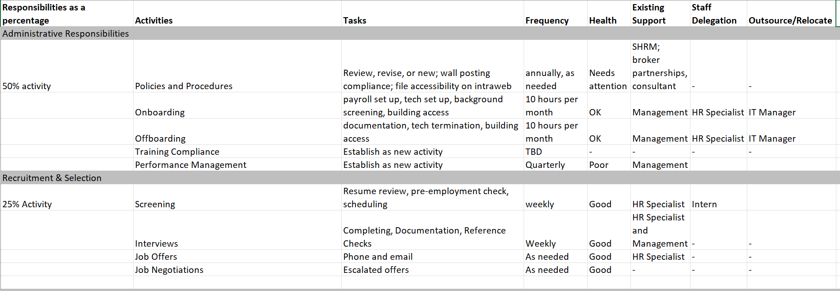
Job Analysis

Slide 40
HR Hierarchy
CEO/ED
HR
Peer Dept
Peer Dept
CEO/ED
Senior Leadership
HR

Slide 41
Emerging Teams
Key Characteristics: Strategic focus and specialized roles
Benefits: Enhanced efficiency, talent acquisition and improved employee experience, compliance and risk management
Challenges: Role clarity and communication
Common titles: 1) HR Manager, HR Director, or CHRO 2) Assistant, Coordinator, or Specialist

Slide 42
HR Hierarchy
COO
HR/IT Director
HR Specialist
Finance Director
HR Manager
HR Coordinator
HR Director/VP
HR Specialist
Intern

Slide 43

Questions

Slide 44
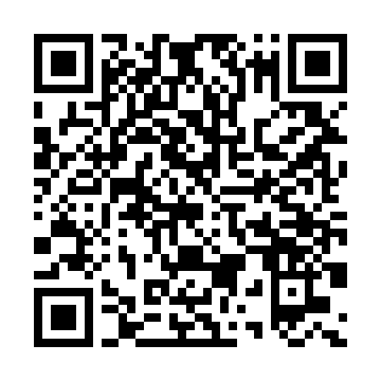
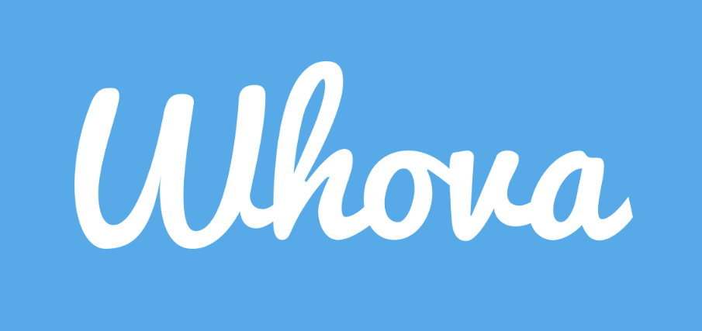
Don’t forget to download the app!

