Slide 1


Bridging the Skills Gap: Strategies for Workforce Development
Presenter: Carrie Arnold
Vice President of Workforce Development,
Cherry Street Mission

Slide 2

What Is Workforce Development?

Slide 3
Why tie in Bridges Out of Poverty concepts?

Slide 4
Why Workforce?
How Cherry Street utilizes WFD
•Shelter
•Food
•Ready for Life
•Mental Health
•Clothing
•Hygiene
•Connections
•Relationships
•Workforce Development

Slide 5
Career Training for the Community
Who We Are
Provider of career-focused education and support designed to reverse the cycle of poverty, body, soul, & spirit
What We Offer
Part-time, short-term, in demand career training with employer connections, job readiness preparation, and wrap-around support

Slide 6


Classes Offered
Welding
Machining
Auto Tech
Building Trades
Office Specialist
Intro to AI and Project Management
Culinary (Food Truck)
New in the fall – Robotics!

Slide 7
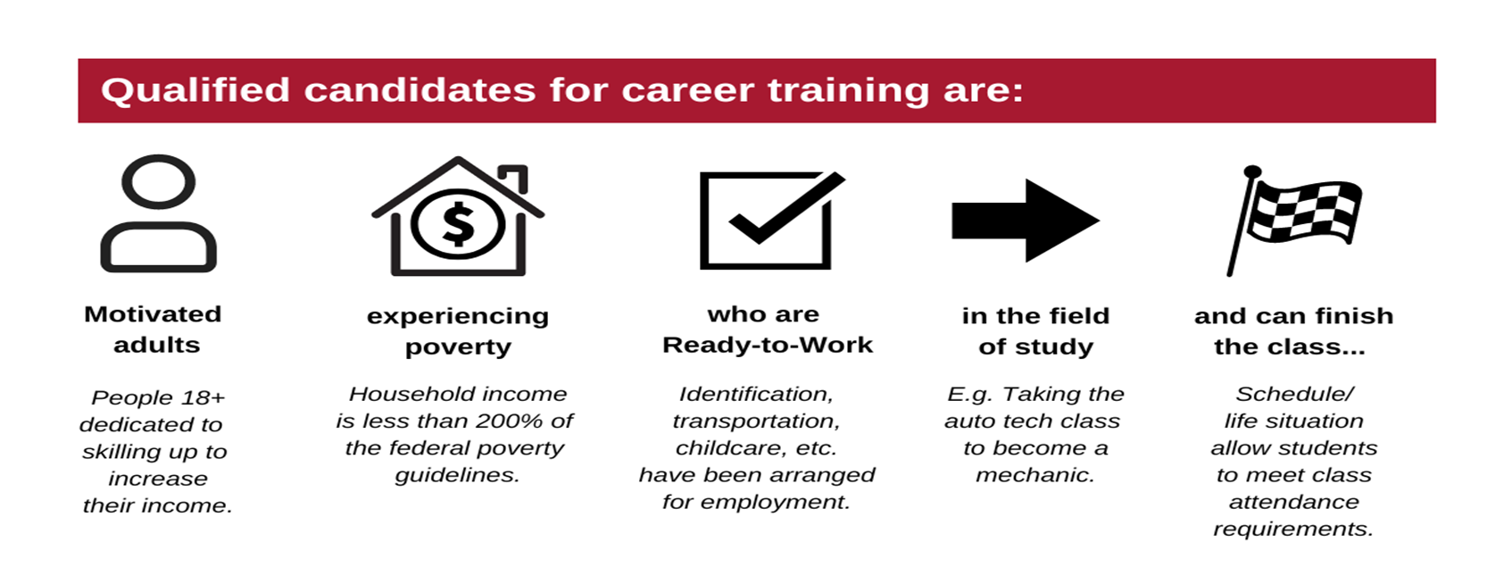
Qualified candidates are:

Slide 8
Who are our students?
59% Do Not have a Drivers License
13% Have no HS Diploma or GED
Only 35% are living on their own without subsidy
46% rely on public transportation
61% have a blemish on their background
58% are not employed
42% are "ALICE" employed
25% are residential guests with Cherry Street
75% come from the community

Slide 9
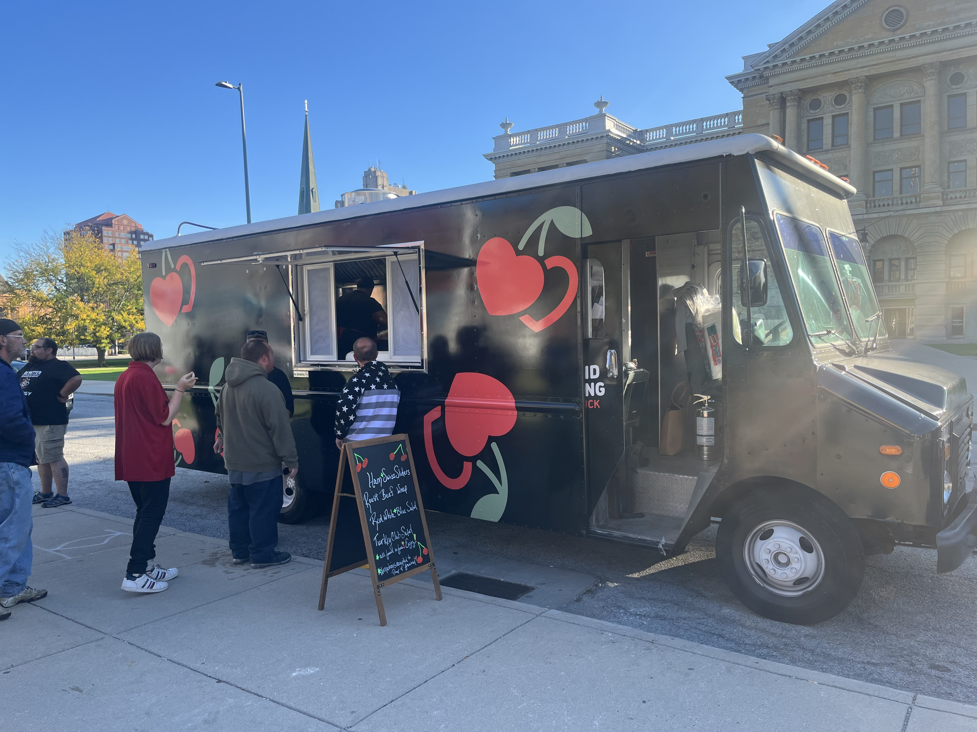
Social Enterprise Intervention (SEI)
Training in culinary and entrepreneurial skills
Converted to employees after graduation
Work on the truck with wrap around support

Slide 10
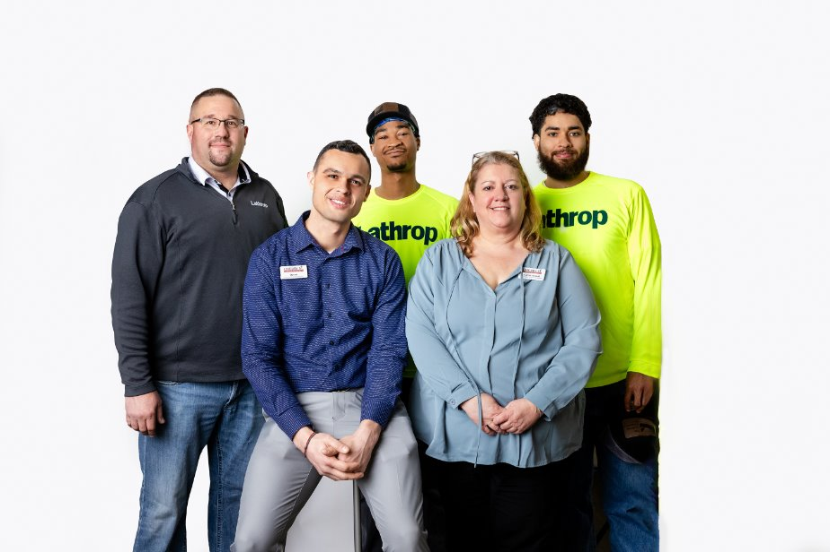
RESULTS
One follow up study showed 80% of graduates were employed within 30 days of graduation, most in the field of study or a related industry.
A full-scale follow up spanning 3-years of classes showed a 70% employment rate with an average wage of over $20/hour.

Slide 11
How does Bridges Out of Poverty fit in?

Slide 12
Let's talk about Poverty!
Mental Models
What Can Daily Instability and Daily Stability Look Like?
24ALICE-Essentials-Index-National-Report-final.pdf

Slide 13
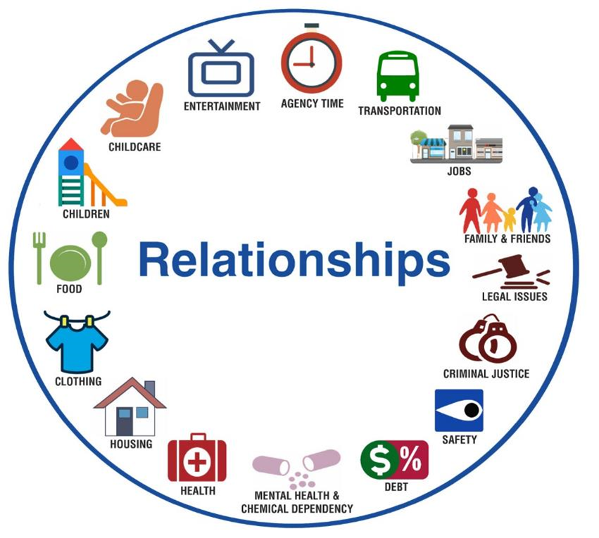
Mental Model for Poverty:

Slide 14
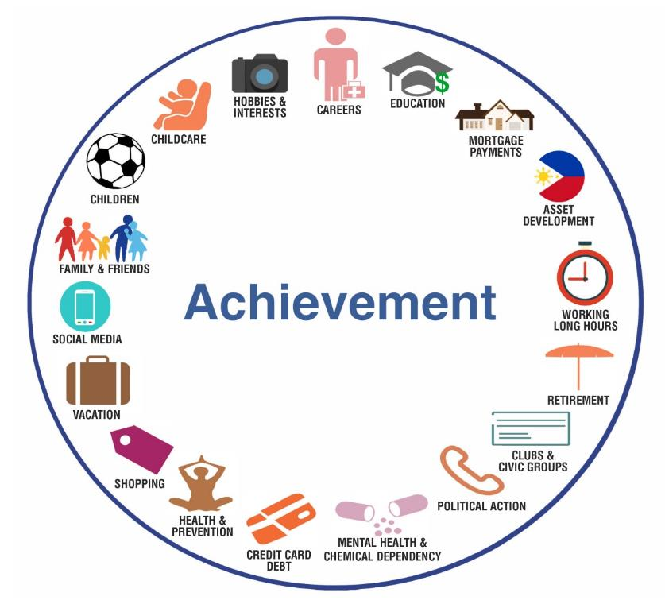
Mental Model for Middle Class:

Slide 15
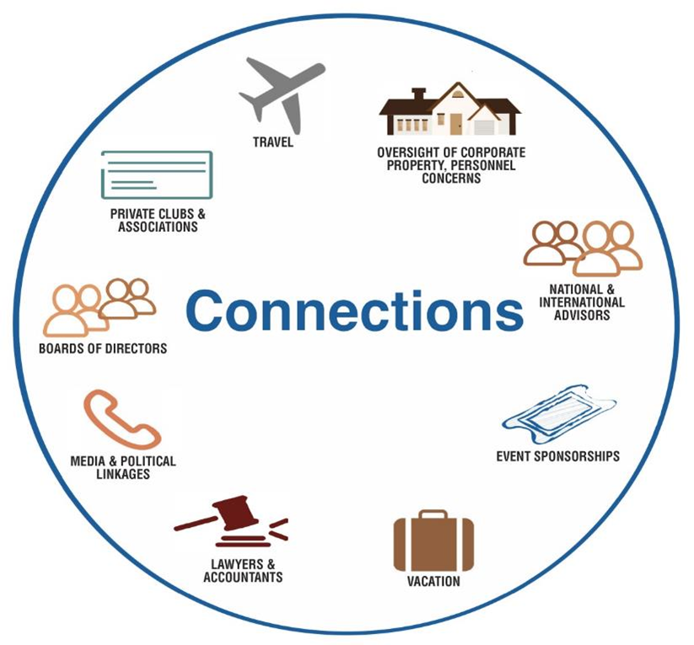
Mental Model for Wealth:

Slide 16
Hidden Rules in the Workplace

Slide 17
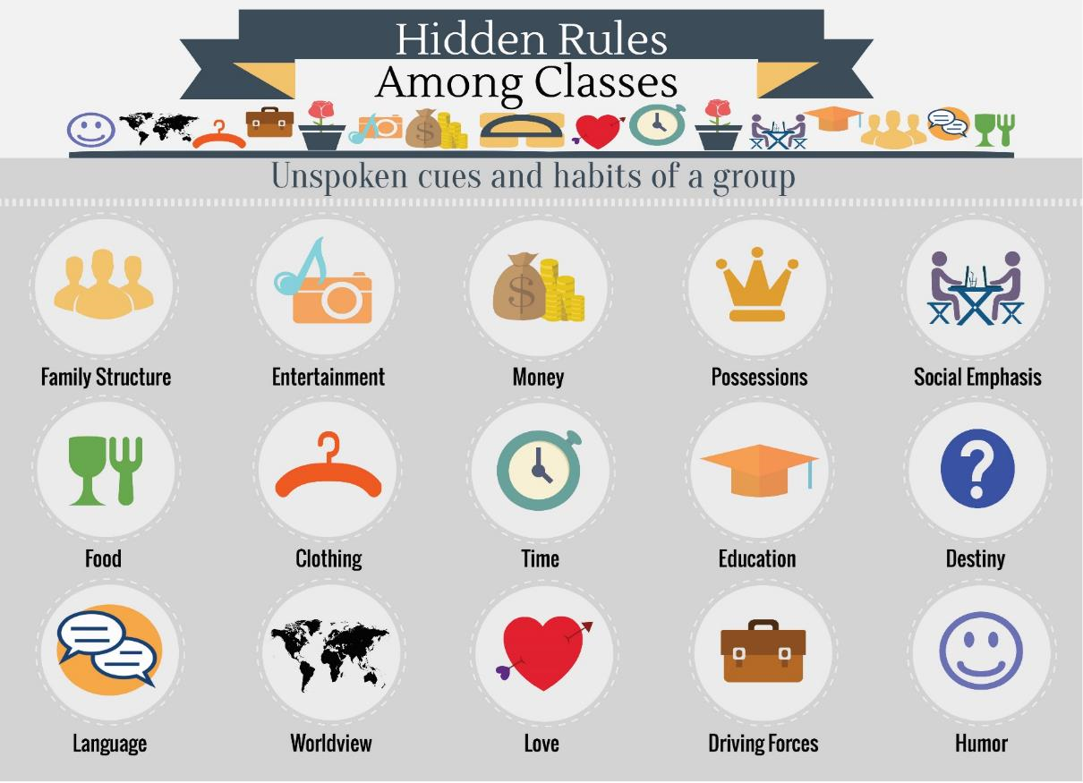

Slide 18
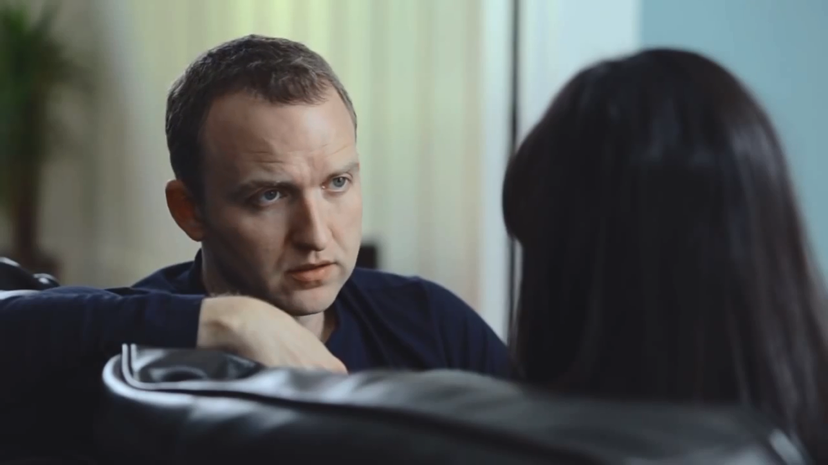
Sometimes...it's about listening
It's Not About the Nail

Slide 19
Resources

Slide 20
Resources
Daily instability is the extent to which an individual does without resources.

Slide 21
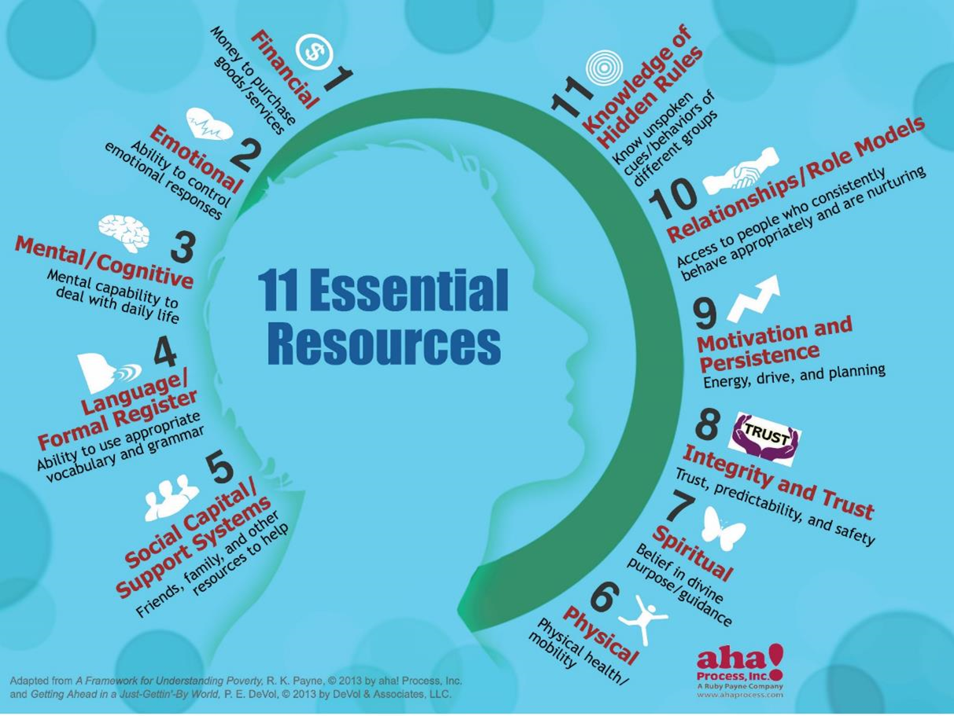

Slide 22
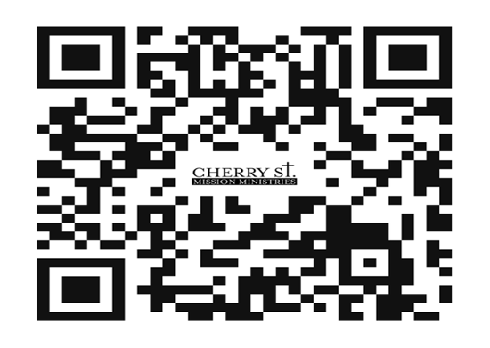
Questions?
Carrie Arnold
Carnold@cherrystreetmission.org
567-661-0362

Slide 23
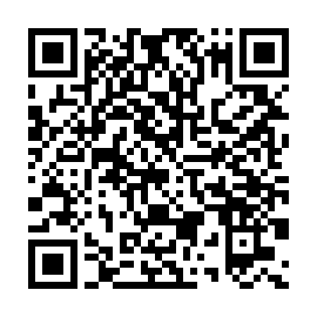
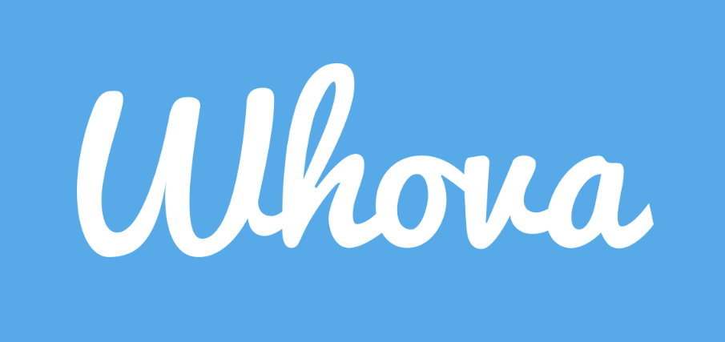
Don’t forget to download the app!

