Slide 1
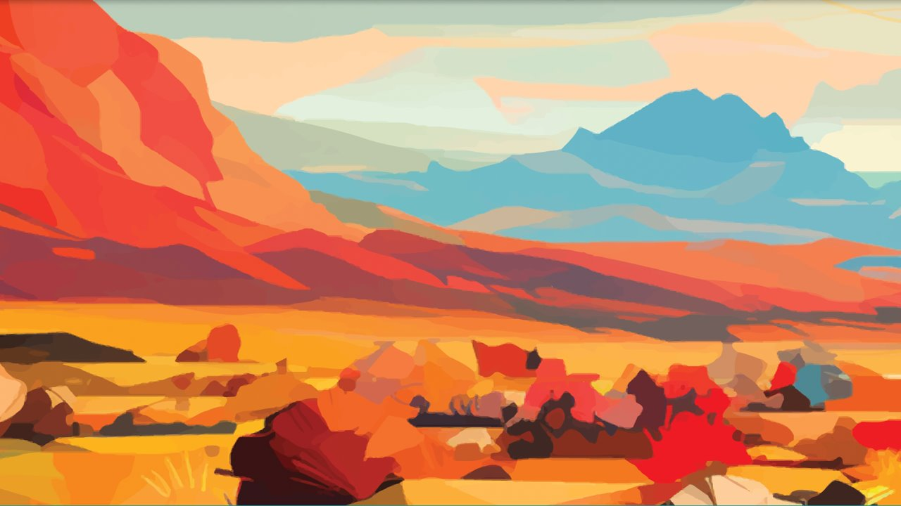
Diversity Equity Inclusion
A biblical perspective
Rev. Jerrel T. Gilliam

Slide 2

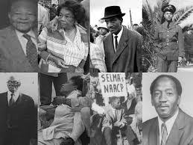
Introduction
Coal mining section: Coverdale
University of Pittsburgh 1980, studied under Rev, Dr. Elmore Williams
Promise Keepers, 1994-98 National Manager of Worship and Training Team
I have 3 children who are interracial from my first marriage, when we moved to Alabama in 1998, interracial marriages were illegal. We voted to end the law.
My wife, Dr. Shannah Tharp Gilliam, is grand daughter to Ernest Doyle, one of the Courageous Eight who invited Dr. King to Selma before Bloody Sunday.

Slide 3

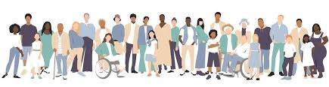
Diversity means the presence and acceptance of differences among people, including race, gender, ethnicity, sexual orientation, disability, age, culture, and more.
DIVERSITY

Slide 4
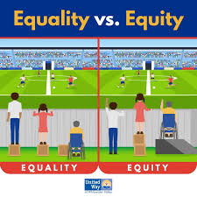
Equity focuses on fairness and justice, providing resources and opportunities tailored to individuals' unique circumstances to achieve equal outcomes, rather than simply offering the same treatment to everyone.
EQUITY

Slide 5
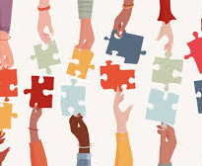
Inclusion means creating an environment where all individuals feel welcomed, respected, and able to fully participate.
INCLUSION

Slide 6
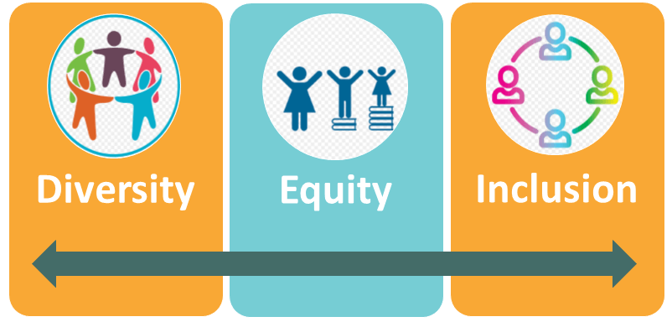
Historically Diversity and Inclusion have been part of the conversation
DEI seeks to bring attention to the continuing disparities between groups.
Diversity and Inclusion have been part of the understanding.
Equity has brought a new tension as it seeks to ensure equal outcomes

Slide 7
The Problem with DEI
DEI seeks to address injustice through human persuasion and compulsion.
DEI begins and ends with a human-centered worldview.
Laws are required to codify societal norms but are not a tool for relational interaction.
True love requires free will and a just society starts with the heart of the individuals.

Slide 8
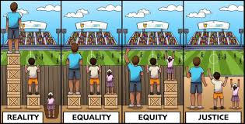
The alternative is Biblical Justice
Biblical Justice initiates with God and His design.
It requires heart transformation.
It is dependent on the individuals living as God requires: modeling heaven’s values on earth.

Slide 9
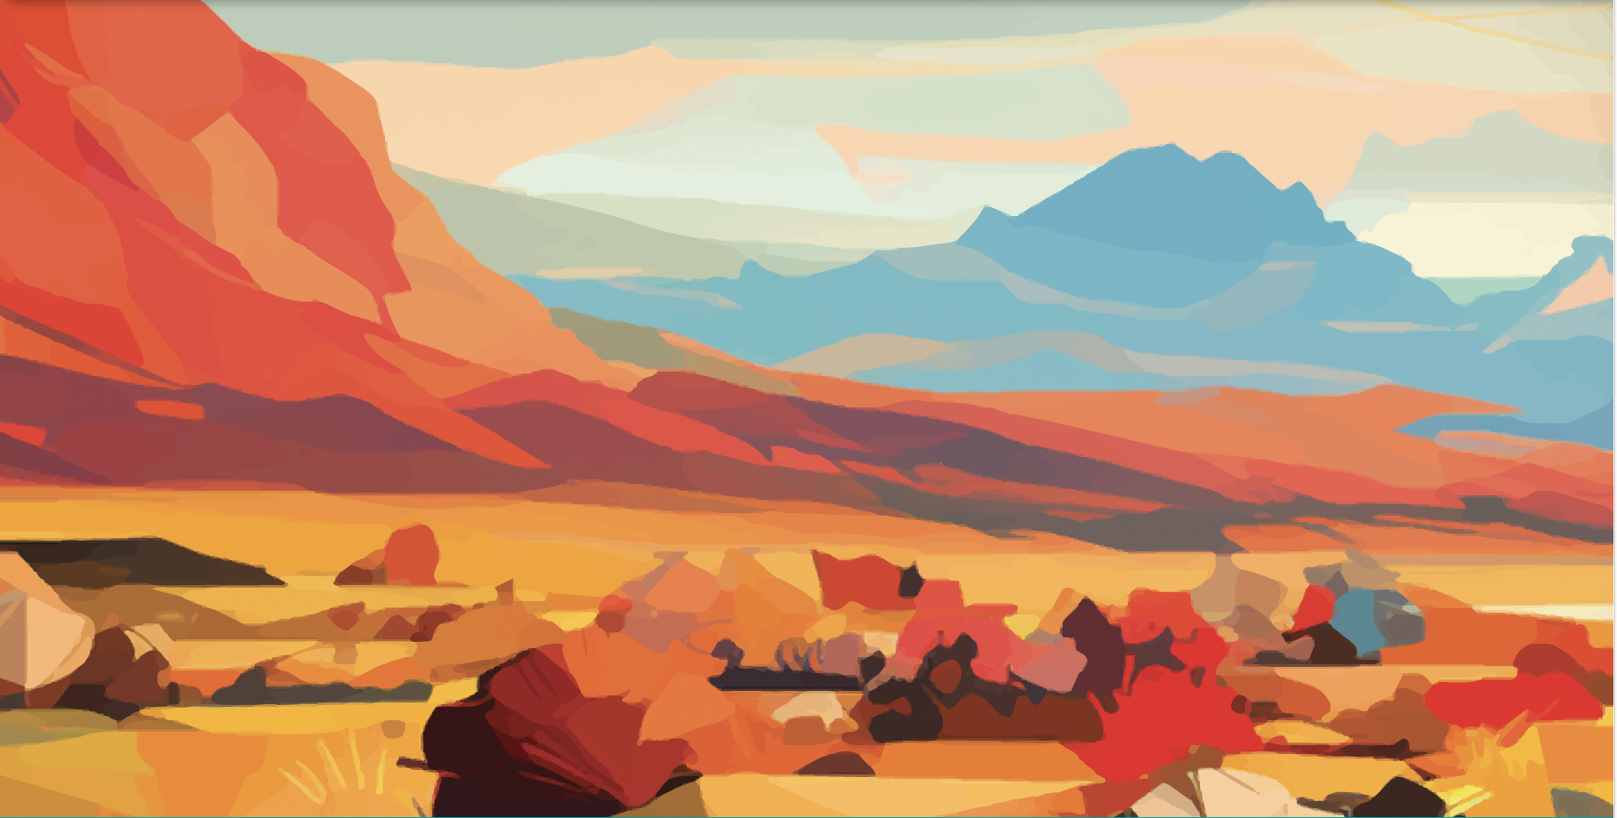
Biblical Justice and Community

Slide 10
Justice and Community
138 times Justice in mentioned in the Bible
God intentionally and consistently describes a community that includes all nations in both testaments.
A Diverse Ethnic community is in the DNA of the Kingdom.
Partiality or favoritism is condemned in both Old and New Testaments

Slide 11
Justice Scriptures
Justice, and only justice, you shall pursue, that you may live and possess the land which the Lord your God is giving you. Deuteronomy 16:20
‘Cursed is he who distorts the justice due an alien, orphan, and widow.’ And all the people shall say, ‘Amen.’ Deuteronomy 27:19

Slide 12
Biblical Community: Old Testament
Abraham: “I will bless those who bless you, And I will curse him who curses you; And in you all the families of the earth shall be blessed.” Genesis 12:3
Isaac: “In your seed all the nations of the earth shall be blessed, because you have obeyed My voice.” Genesis 22:18
Jacob: “Also your descendants shall be as the dust of the earth; you shall spread abroad to the west and the east, to the north and the south; and in you and in your seed all the families of the earth shall be blessed.” Genesis 28:14
“Thus says the Lord of hosts: ‘In those days ten men from every language of the nations shall grasp the sleeve of a Jewish man, saying, “Let us go with you, for we have heard that God is with you.” Zechariah 8:23

Slide 13
Biblical Community: New Testament
And there were dwelling in Jerusalem Jews, devout men, from every nation under heaven. Acts 2:5
But in every nation whoever fears Him and works righteousness is accepted by Him. Acts 10:35

Slide 14
Biblical Inclusion: New Testament
“And He has made from one blood every nation of men to dwell on all the face of the earth, and has determined their preappointed times and the boundaries of their dwellings, so that they should seek the Lord, in the hope that they might grope for Him and find Him, though He is not far from each one of us” Acts 17:26-27

Slide 15
Biblical Inclusion: New Testament
And they sang a new song, saying:
“You are worthy to take the scroll, And to open its seals; For You were slain,
And have redeemed us to God by Your blood Out of every tribe and tongue and people and nation, And have made us kings and priests to our God; And we shall reign on the earth.” Revelation 5:9-10

Slide 16
Biblical Inclusion: New Testament
Then I saw another angel flying in the midst of heaven, having the everlasting gospel to preach to those who dwell on the earth—to every nation, tribe, tongue, and people” Revelation 14:6

Slide 17
Where do we go from here?

Slide 18
Ephesians 6:11-13
Put on the whole armor of God, that you may be able to stand against the wiles of the devil. For we do not wrestle against flesh and blood, but against principalities, against powers, against the rulers of the darkness of this age, against spiritual hosts of wickedness in the heavenly places. Therefore take up the whole armor of God, that you may be able to withstand in the evil day, and having done all, to stand.

Slide 19
2 Corinthians 10:4-6
For the weapons of our warfare are not carnal but mighty in God for pulling down strongholds, casting down arguments and every high thing that exalts itself against the knowledge of God, bringing every thought into captivity to the obedience of Christ, and being ready to punish all disobedience when your obedience is fulfilled.

Slide 20
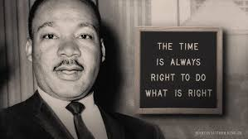
1. Pray for God’s perspective
We can not bring transformative change to a problem with the same mindset that created the problem.
"Darkness cannot drive out darkness: only light can do that. Hate cannot drive out hate: only love can do that."
- Martin Luther King, Loving Your Enemies, Strength to Love, 1963

Slide 21
A Stronghold
“A spiritual stronghold is a mindset impregnated with hopelessness that causes the believer to accept as unchangeable something that is contrary to the will of God.”
Dr. Ed Silvoso

Slide 22
Forgiveness breaks strongholds
DEI shackles healing to the repentance and transformation of the perpetrators.
DEI also places the sins of the fathers and grandfathers on the children.
A person in deep trauma must forgive to get free.

Slide 23
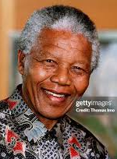
2. We must freely give and receive forgiveness.
Forgiveness frees us from the emotional chains of the perpetrators of our trauma, unforgiveness tethers us to the illusion that they control our destiny.
Madella and Robbin Island lesson
Surrender the right to retaliate!

Slide 24
Concluding Thoughts

Slide 25
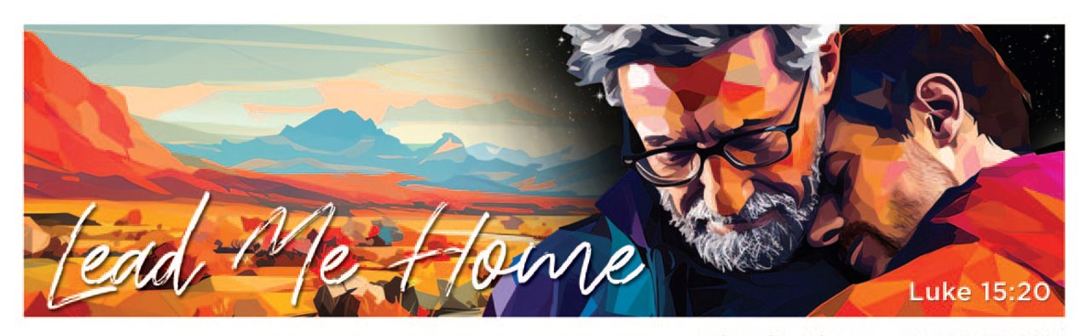
3. Lead with Love
Our limitation is not of human design. Our limitation is in our small view of God and understanding His power He has entrusted to us to change the world for good.
Love God and Love People
“He has shown you, O man, what is good;
And what does the Lord require of you
But to do justly, To love mercy, And to walk humbly with your God?” Micah 6:8

Slide 26

Thank you!!
Questions, Answers or Comments?

