Slide 3
Go for the Giving Season Goal!
Your strategy
to keep the giving going all season long

Slide 4
The 2019 Giving Season
Nov. 16-24 Hunger & Homelessness Awareness Week
Nov. 28 Thanksgiving Day
Dec. 3 Giving Tuesday
Dec. 25 Christmas Day
Dec. 31 Year-end

Slide 5
Get Essential
Remember that if you don’t prioritize your life, someone else will. Greg McKeown, Essentialism
Only once you give yourself permission to stop trying to do it all, to stop saying yes to everyone, can you make your highest contribution towards the things that really matter. Greg McKeown, Essentialism

Slide 6
The September Countdown
BE PROACTIVE INSTEAD OF REACTIVE
What are your Giving Season goals and
what will it take to reach them?
Plan a continuum of education, motivation and activation that takes you smoothly from September 1 through December 31

Slide 7
Set S.M.A.R.T. Goals
SPECIFIC, understandable goals for your donors
MEASURABLE goals you and your donors can track
ACHIEVABLE goals with clear steps to reach them
RELEVENT goals that answer direct needs
TIME-SENSITIVE goals to meet immediate needs

Slide 8
EDUCATE: What does the donor/volunteer need to know about you and who you serve?
MOTIVATE: What does the donor/volunteer need to know to be inspired to engage?
ACTIVATE: What does the donor/volunteer need to know to take the first step?

Slide 9
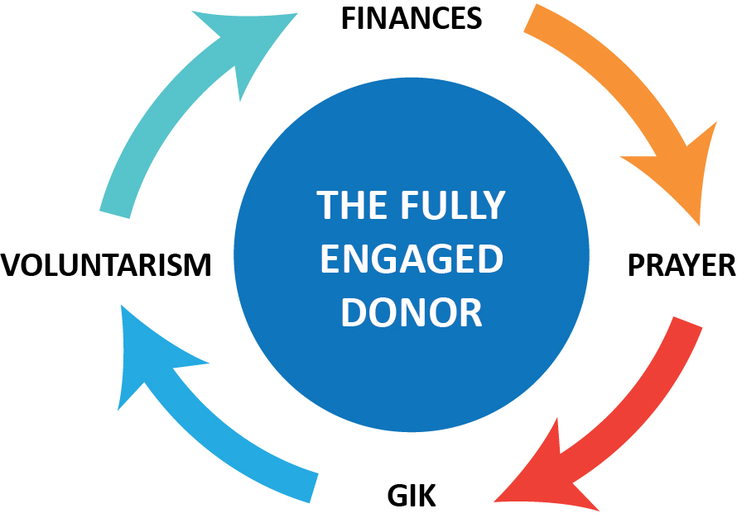
The Cycle of Giving

Slide 10
Fully Engaged Partners!
How am I educating, motivating and activating our:
Financial partners
Volunteers
In-kind donors
Prayer warriors
Advocators

Slide 11
A Checklist for Every Holiday
WHAT’S ON YOUR LIST?
Direct Mail
Newsletters
E-blasts and E-newsletters
Social Media
Website Homepage
Fliers and Other Disposables
Exhibit Materials

Slide 12
A Checklist for Every Holiday
Media Releases
Advertising
Volunteer Promotions
Church Promotions
Donor Events, Drives
Staff Collaboration
Program Collaboratives

Slide 13
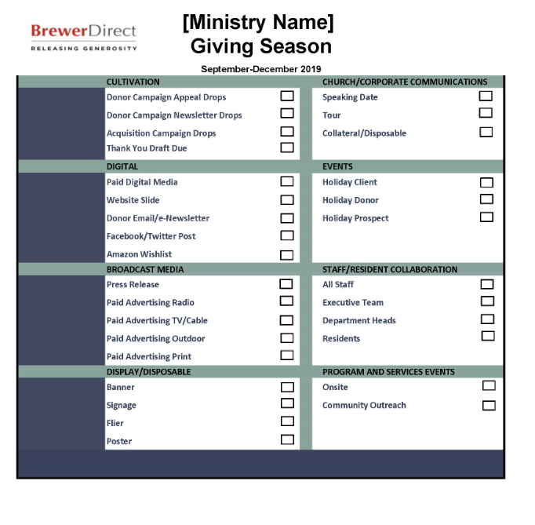
Adapt this checklist for your ministry’s use … one for every holiday! Check each box to reach your Giving Season goal.

Slide 14
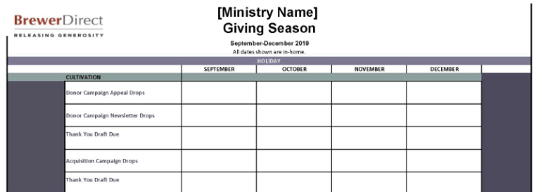
From Checklist to Calendar
Use your fillable calendar to draft a continuum including everything from direct mail to planning meetings, projects, production and events.

Slide 15
Opportunities for Investment
Identify and add to your calendar:
Thanksgiving and Christmas food collections
Christmas gift collections
Volunteer opportunities for individuals and groups
Small and large ministry needs that leverage restricted gifts
Corporate team-building or community service projects
Drives for needs that come up all year long

Slide 16
Meetings and Production
Identify and add to your calendar:
Staff and volunteer meeting dates
Internal events such as “all-staff Christmas party”
Days when the facility will be closed
Materials production deadlines
Media release dates and social media updates

Slide 17
Your Takeaways
Be Proactive: Retreat and get the job done early
Be Intentional: Plan to impact and not distract
Be Creative: Educate, motivate, activate
Be Accountable: Keep the checklist front and center
Be on Time: Stay on top of your calendar items

Slide 18
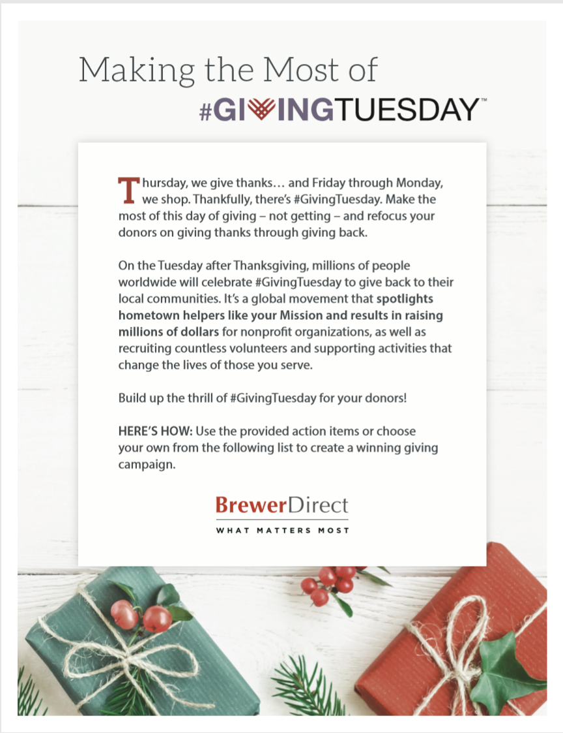
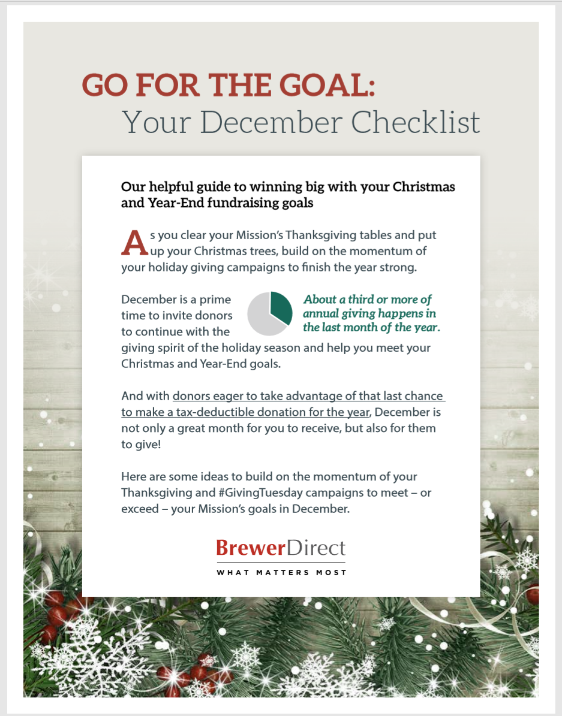

Slide 19
A Final Word from the Essentialist
“We can easily do two things at a time…. What we can’t do is concentrate on two things at the same time…. Multi-tasking is not the enemy … pretending we can multi-focus is.”
– Greg McKeown, Essentialism

