Slide 1
Rescue Missions Giving Trends
Citygate Network Webinar
March 6, 2019

Slide 2
Giving Trends
2018 Industry & Rescue Mission Performance
  Tax reform early reads
Diversifying & Strengthening Income
  Growth areas: digital, monthly sustainer, major giving

Slide 3
Industry
Performance

Slide 4
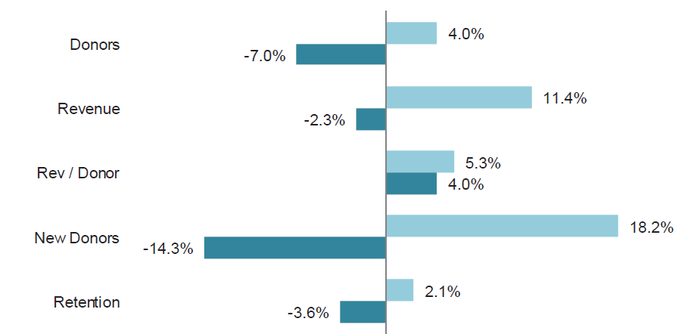

Q3 Performance: all sectors
Overall Target Analytics benchmark showed that the drop in new and active donors was not offset by higher revenue per donor, resulting in a revenue drop of -2.3% for the 12 months ending 9/30/18.

Slide 5
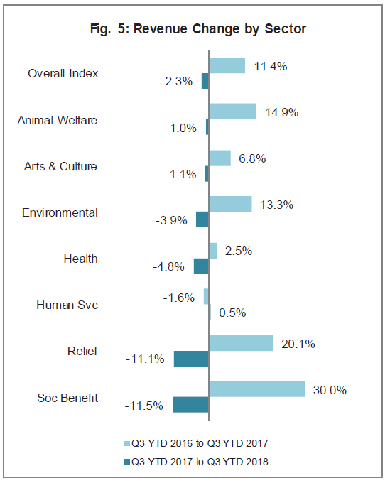
Q3 Performance
The six Human Services orgs in the Target Analytics benchmark fared the best, with a nearly flat revenue increase of +0.5% for the 12 months ending 9/30/18.
Source: Target Analytics Q3 2018 Index of Direct Marketing Fundraising Report, January 2019.
Human Services include American Indian Relief Council, Covenant House, Disabled American Veterans, Feeding America, Make-A-Wish Foundation, Paralyzed Veterans of America.

Slide 6
Rescue Missions 2018 Performance

Slide 7
Q3 Performance: O&A Missions Benchmark
+4.1% YOY

Slide 8
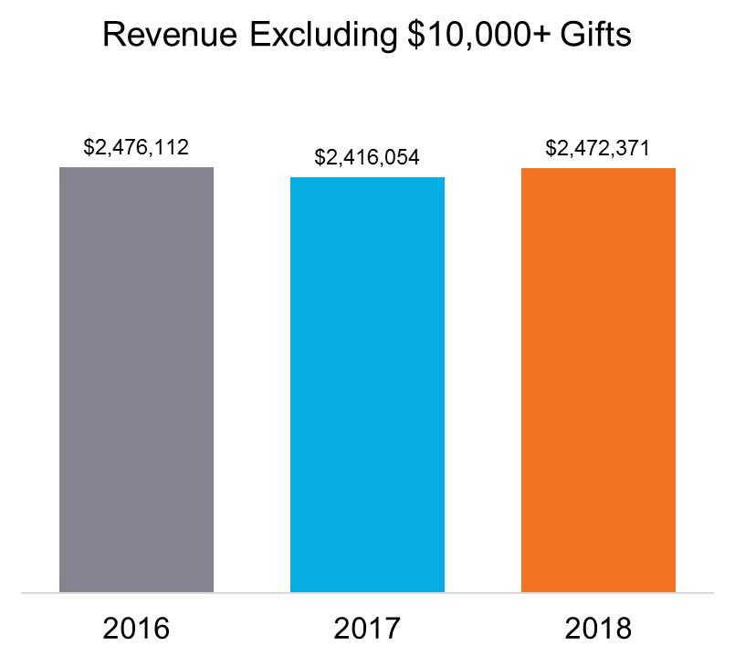
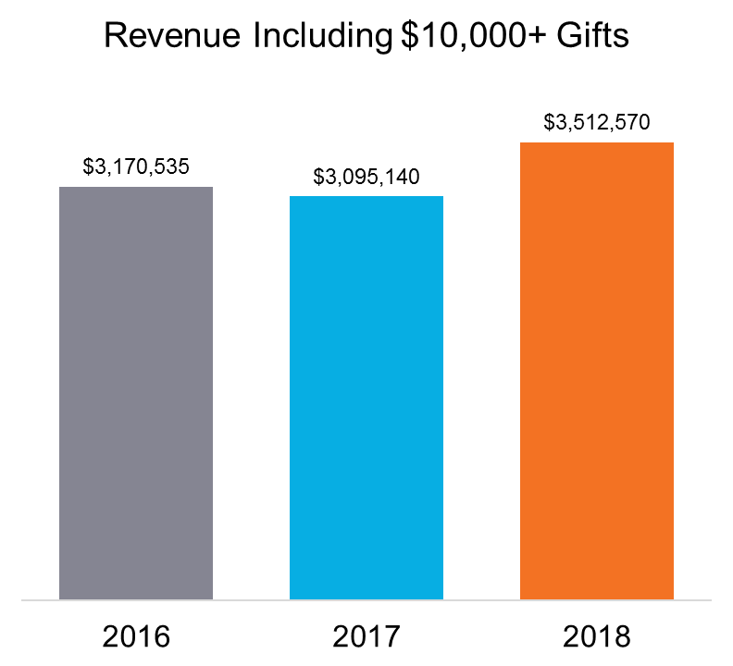
Giving Tuesday: O&A Missions Benchmark
-2.4% YOY
+2.3% YOY
-2.4% YOY
+13.5% YOY

Slide 9
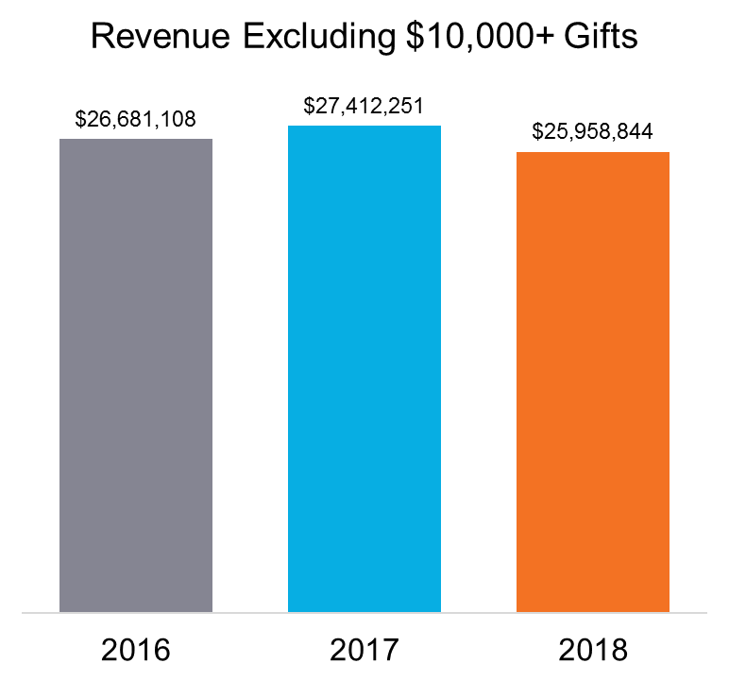
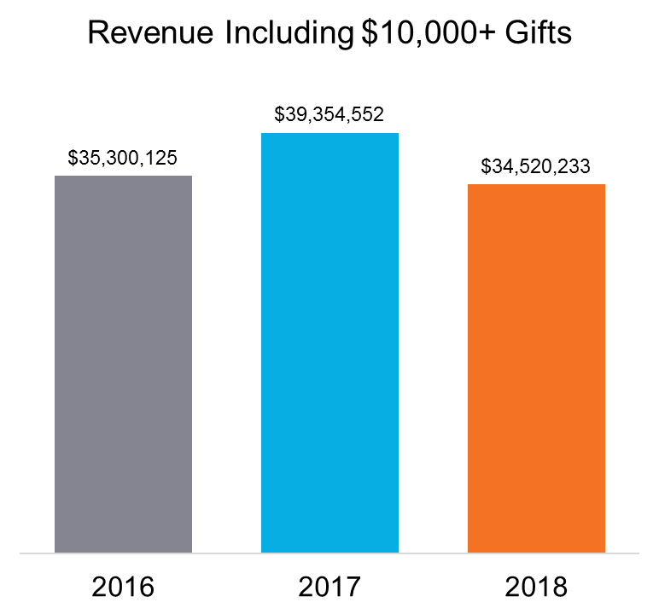
December: O&A Missions Benchmark
+2.7% YOY
-5.3% YOY
+11.5% YOY
-12.3% YOY

Slide 10
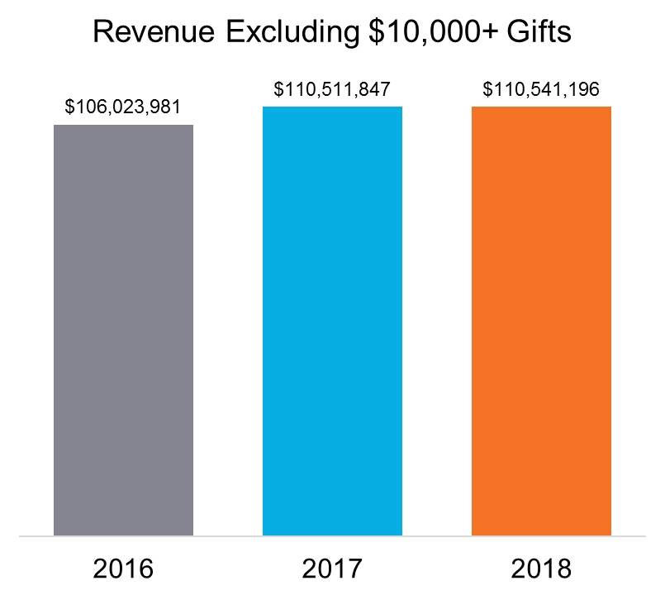
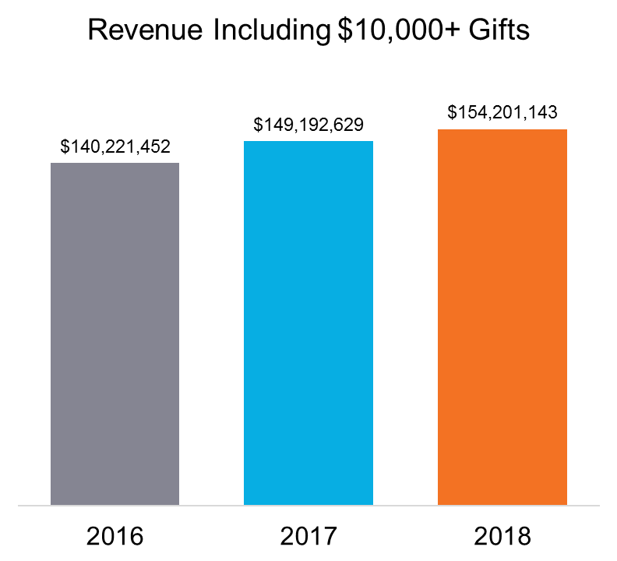
Jan-Dec: O&A Missions Benchmark
+4.2% YOY
+0.03% YOY
+6.4% YOY
+3.4% YOY

Slide 11
What About Tax Reform?

Slide 12
Tax Reform Summary
Avg. 2.2%
Reduces the number who can itemize their deductions, from 26% of HHs to ~10%.
80% of HHs are expected to pay less in 2018 taxes, 5% more, 15% about the same.
On average, Americans are getting a 2.2% payroll boost in the form of lower tax withholding in their paychecks.
  Higher increases for top-earning households, boding well for major giving

Slide 13
Giving Predictors
Surprisingly, income is more predictive of charitable giving than age! But, amount donated does increase with age.

Slide 14
What About December 31?
Using the last day of the year as a proxy for understanding tax-based urgency, we compared the same 41 rescue mission clients for 2017 and 2018 giving comparisons on the last day of the year…

Slide 15
2017

Slide 16
2018

Slide 17

Tax Reform Status
2018 insights were muddled by the worst December stock market performance since the Great Depression.
Tailwind of inertia, with slightly more gifts and revenue last day of 2018 vs. 2017: “Charitable gifts are tax deductible.”
Still early to gauge; we are in the “learning curve” now: tax season 2018.
Bunching strategies will be learned, leading to additional variability in revenues.

Slide 18
Diversifying & Strengthening Income

Slide 19
Setting the Stage: 2018 Overall Performance
+4.2% YOY
+0.03% YOY
+6.4% YOY
+3.4% YOY

Slide 20
Distribution of YOY Revenue Change
Overall Missions Benchmark = +0.03%
Opportunity to create your own trend!
Each category represents the year over year change in revenue from 2017 to 2018 (ex: 24% of clients saw a YOY revenue change of +/-1%).
Excludes gifts of $10,000+. Total client count = 45 (Missions benchmark plus other rescue missions with available data files.)

Slide 21
What Do the Leaders Have In Common?
Strong brands have many purposeful attributes, including the following:
Strong retention through intentional cultivation and communication
Strong digital programs (acquisition and cultivation)
Focus on sustaining, monthly donors (acquisition and conversion)
Major gift cultivation

Slide 22
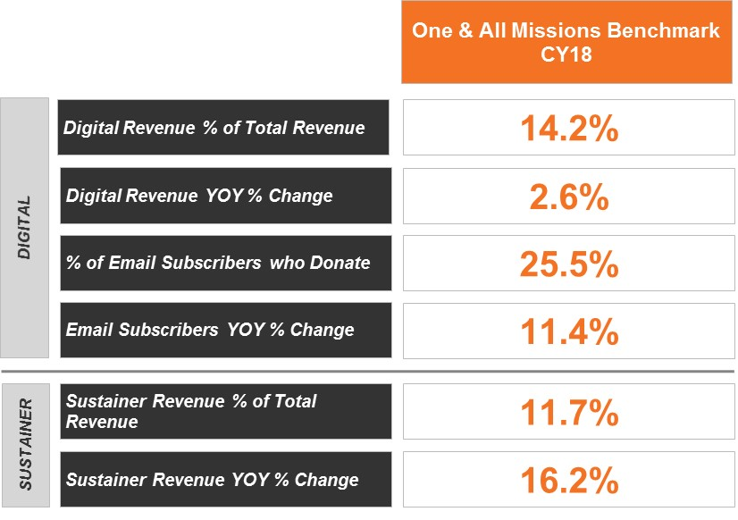
Digital & Sustaining Revenue
How Do You Compare?
Digital revenue (representing 14.2% of direct response revenue) continued to grow, at a slower clip.
Gains in email addresses still strong.

Slide 23
Digital & Sustaining Revenue
How Do You Compare?
Sustainer revenue (representing 11.7% of direct response revenue) growing at 16.2% YOY.

Slide 24
Summary
While rescue missions on average had a flat revenue year excluding major gifts (+0.03%), nearly one-third (31%) of organizations beat their own performance by 5% or more.
Opportunities to strengthen your mission’s performance:
1) Digital (acquisition + cultivation)
2) Sustainer focus (acquisition + conversion)
3) Purposeful major gift program…

Slide 25
Clarifying Questions?

Slide 26
Contact
Lori Connolly - VP, Research & Analytics
lori.connolly@oneandall.com

