Slide 1
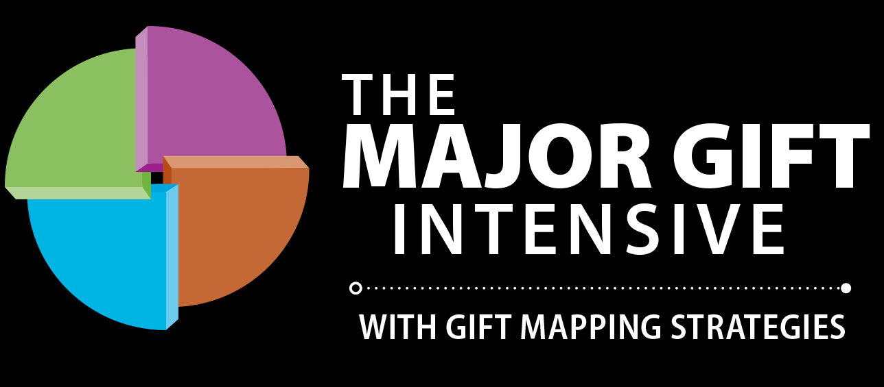
Notes:
It is called The MAJOR GIFT INTENSIVE

Slide 2
A Framework for building relationships!

Slide 3
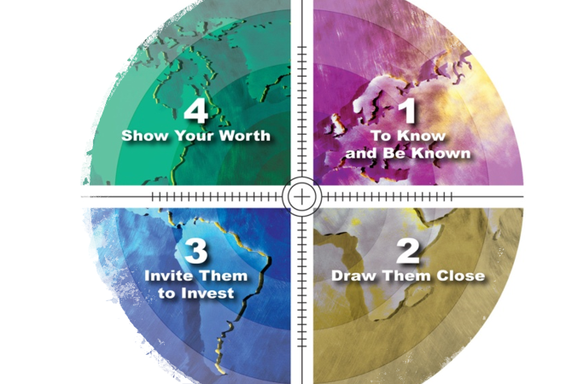
Gift Mapping Strategies

Slide 4
“Double Funnel” Major Gift Marketing
Personal
Program
Major Gift Zone
50%
50%

Slide 5
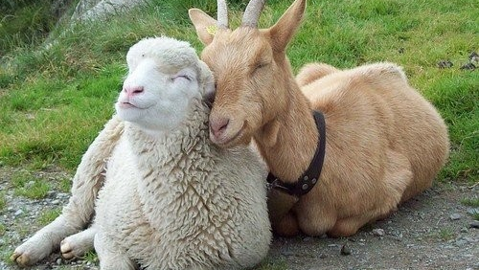
It’s not just being friends…

Slide 6
A Major Donor “Equation”
(I+R)E² = C

Slide 7
A Major Donor “Equation”
(I+R)E² = C
I represents INFORMATION
R represents RELATIONSHIP
E² represents EMOTIONAL ENGAGMENT

Slide 8
A Major Donor “Equation”
(I+R)E² = CHAMPION

Slide 9
Information Items
Annual Report
Impact Report
Names of Board of Directors
Financial Information
Program Details
Number of people served
Location of your programs
Number of Staff
Leadership Team
Biography of CEO
Denominational Affiliation
Key Partnerships
Statement of Faith
Doctrinal Position

Slide 10
Relationship Items
Dinner with president
Golf or sporting activity
Donor events
Prayer Teams
Meeting faculty, program directors
Meeting leadership
Travel trip with other donors
Service/volunteer opportunities
Connection with other donors
Relationship with beneficiaries

Slide 11
Emotional Engagement Ideas
Hand-written testimony of a beneficiary
Meeting with a beneficiary
Receiving a special honor or award
Invitation to serve on a committee or board
Naming opportunities

Slide 12
A 16-step strategy over 9 months

Slide 13
The 10-year map of “Mark and Cindy”
Step 1 – Met at Camp
Step 2– Asked for 1st gift, $8K-$12K
Step 3– Invited to a major donor event – committed $150,000
Step 4– after 9/11 Here’s Hope packets with their CD - $80,000 in kind-gift
Step 5 Invited to lead worship at PC - $250K
Step 6 – Lead worship at PC
Step 7 – began literature partnership – renewed $250K commitment
Step 8 – World Impact Award - $500,000
Step 9 – Extended literature partnership $2.1 million

Slide 14
Personal vs Personalization
“Dear Friend” is neither
“Don’t treat me like me you know me when you don’t.”
“Don’t treat me like you don’t know me, when you do!”

Slide 15
Action Types
Phone (or text)
Letter or Email
Visit or Meeting

Slide 16
Implementation is Key!
Commitment to the donor is a must & planning is essential.

Slide 17
A prescription…
Focus on the few
Segment for capacity AND interest
90% of $ in a growth campaign will come from 10% of donors
Make an intentional plan
Plan your touch-points for 12 months in advance
1 meaningful “touch” per month
“Lean-in”
Follow-through

Slide 18
Bonus Material
Want to know how your major gifts program could be strengthened?
Please send your email and I will email you a brief self- assessment.
Support@elevationgrowth.com

Slide 19
Thank you!
You can reach us at
Support@elevationgrowth.com
http://www.elevationgrowth.com/majorgiftintensive/
Notes:
It is called The MAJOR GIFT INTENSIVE

